Slide 1
Coupledline Compiled Data
2025-08-22_05_30

Slide 2
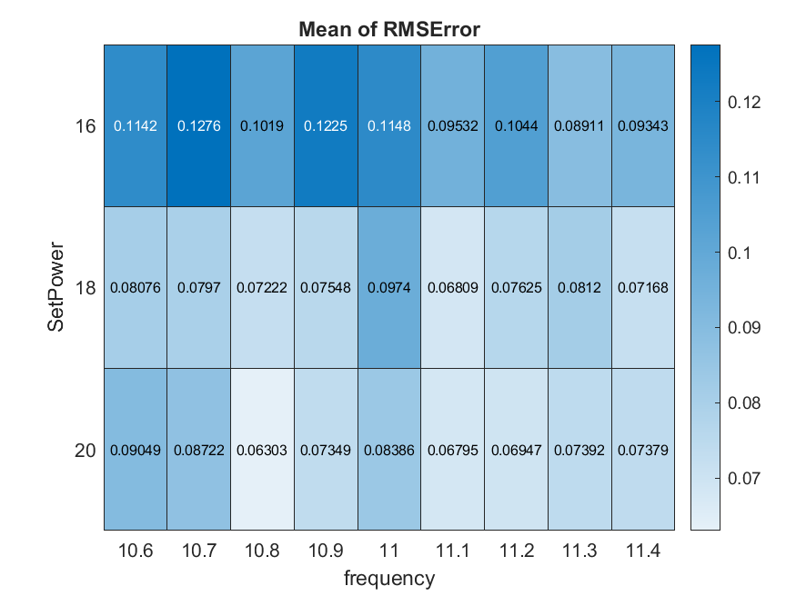
Bias 1

Slide 3
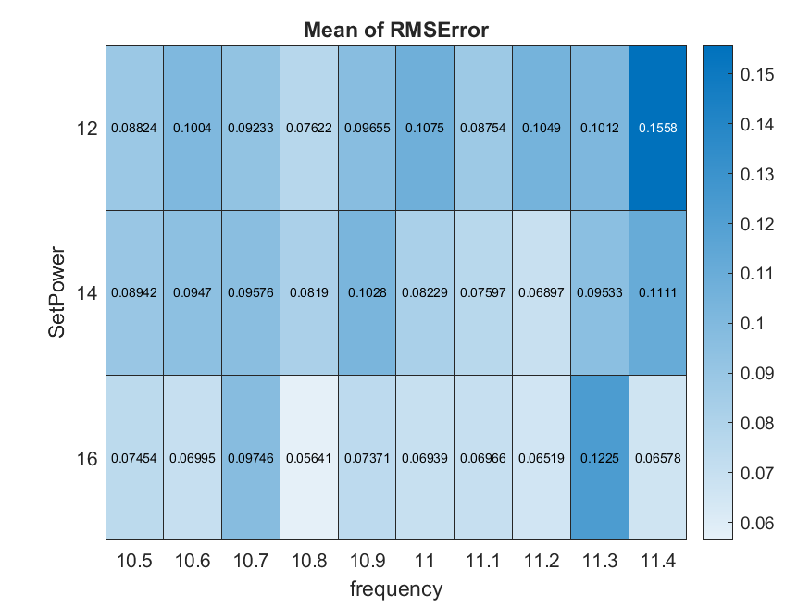
Bias 2

Slide 4
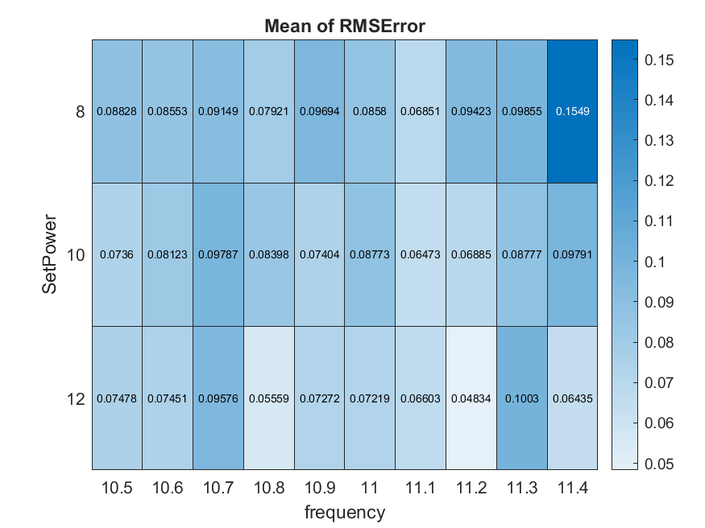
Bias 3

Slide 5
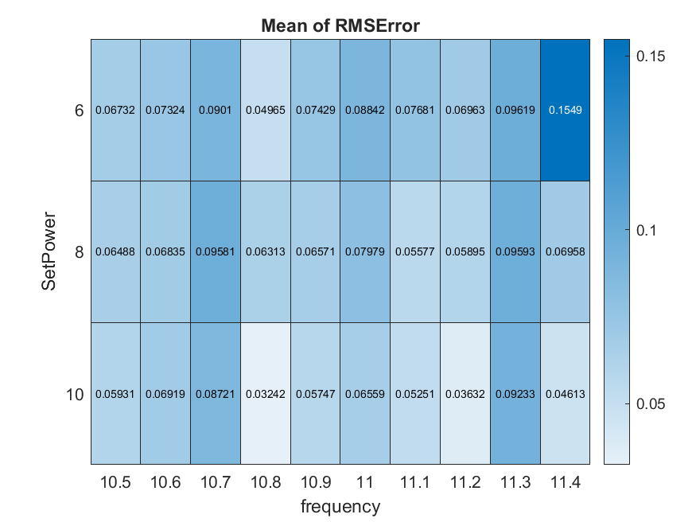
Bias 4

Slide 6
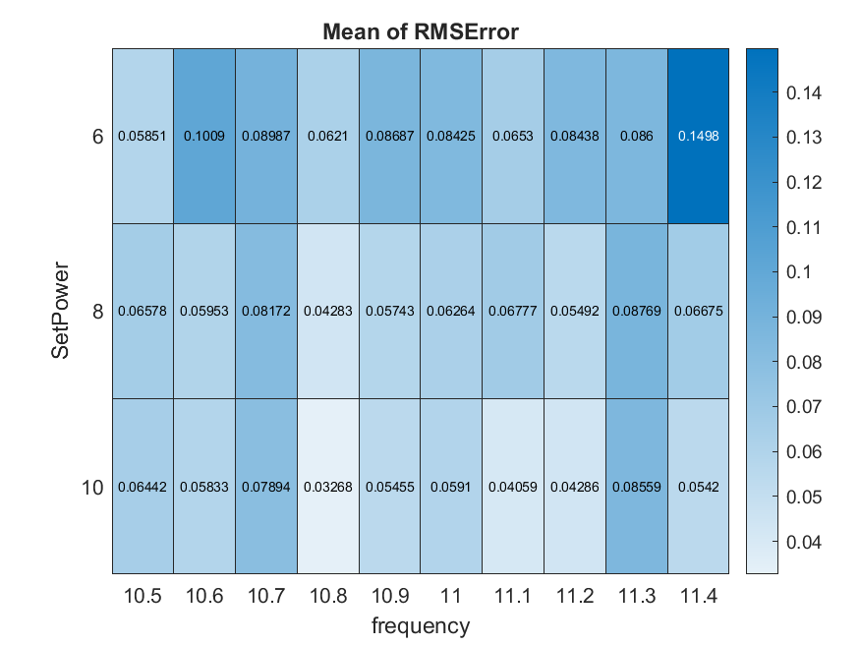
Bias 5

Slide 7
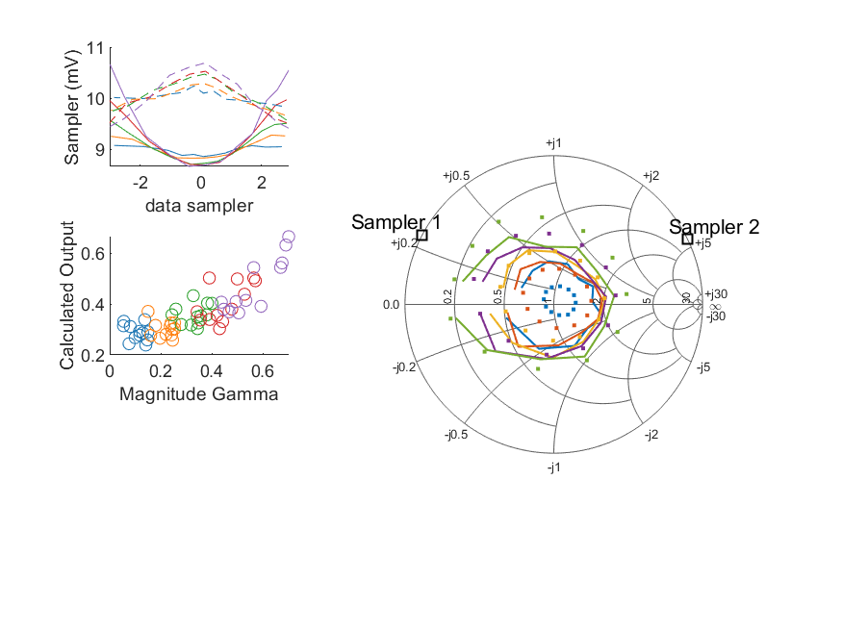
Coupled Line Performance At 10.60 GHz, 16.000000 dBm Output Power 1.00 V mean sampler bias
Sampler Av
Sampler 1: 300.000
Sampler 2: 300.000
Sampler Offset (rather than -1)
-5.1509345706036269
Goodness Of fit
0.30371679964073289
Sampler 1 Range
0.0019920916400000006
Sampler 2 Range
0.0012764781300000014
DUT output dBm Mean
15.977000064873708
DUT input dBm Mean
16.536866404249761
RMS Error
0.11417839771841791

Slide 8
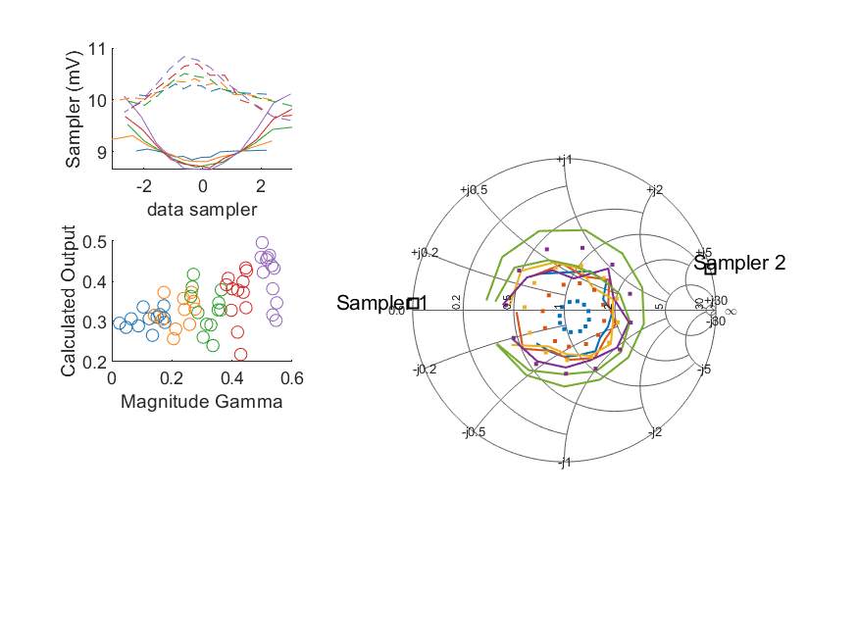
Coupled Line Performance At 10.70 GHz, 16.000000 dBm Output Power 1.00 V mean sampler bias
Sampler Av
Sampler 1: 252.892
Sampler 2: 252.892
Sampler Offset (rather than -1)
-5.2280860315658639
Goodness Of fit
0.35573873891361585
Sampler 1 Range
0.0014599805300000001
Sampler 2 Range
0.0012302323799999997
DUT output dBm Mean
16.006374434490748
DUT input dBm Mean
16.432863244257156
RMS Error
0.12756777641139908

Slide 9
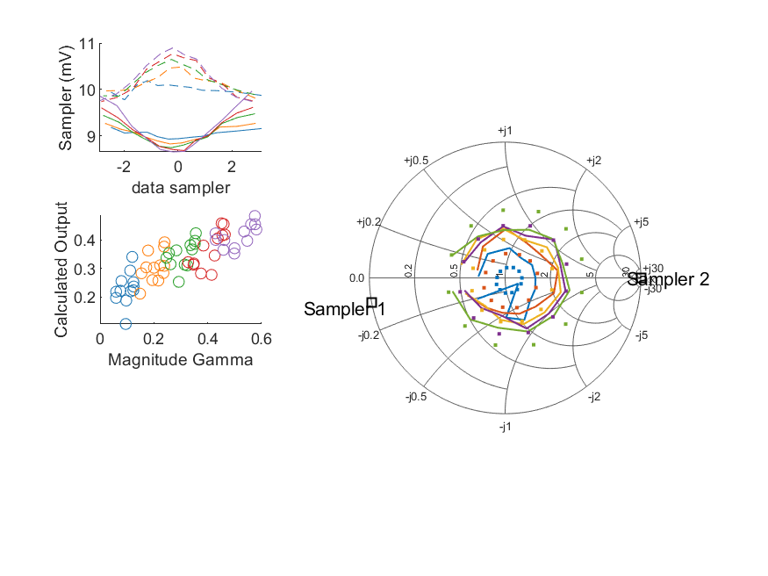
Coupled Line Performance At 10.80 GHz, 16.000000 dBm Output Power 1.00 V mean sampler bias
Sampler Av
Sampler 1: 222.439
Sampler 2: 222.439
Sampler Offset (rather than -1)
-4.9613291699450244
Goodness Of fit
0.23743191456744561
Sampler 1 Range
0.0013072972599999996
Sampler 2 Range
0.0011553791300000001
DUT output dBm Mean
15.992523832146315
DUT input dBm Mean
16.441726796609444
RMS Error
0.10185058168249191

Slide 10
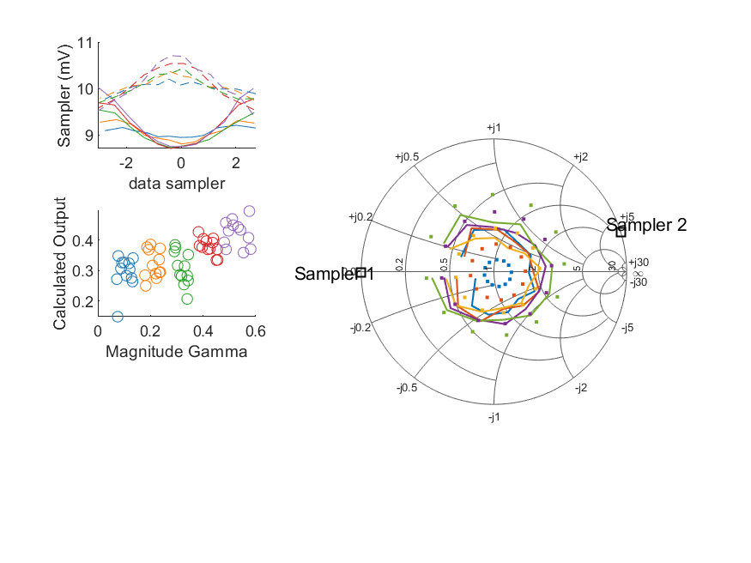
Coupled Line Performance At 10.90 GHz, 16.000000 dBm Output Power 1.00 V mean sampler bias
Sampler Av
Sampler 1: 295.112
Sampler 2: 295.112
Sampler Offset (rather than -1)
-5.5921705384714633
Goodness Of fit
0.33208989591557792
Sampler 1 Range
0.0013203513900000002
Sampler 2 Range
0.00127373668
DUT output dBm Mean
15.981332574735848
DUT input dBm Mean
16.502310854756875
RMS Error
0.12253427334972421

Slide 11
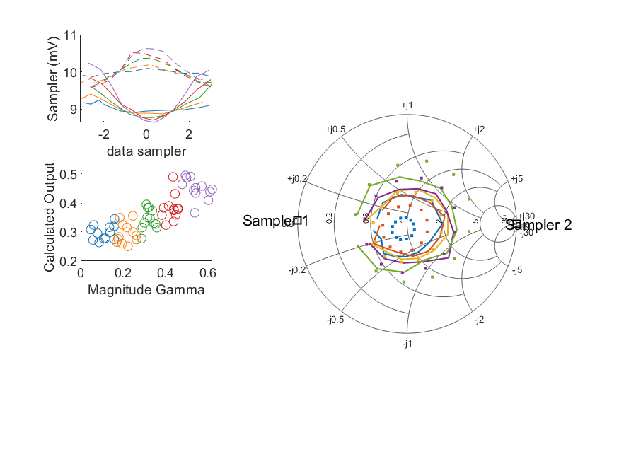
Coupled Line Performance At 11.00 GHz, 16.000000 dBm Output Power 1.00 V mean sampler bias
Sampler Av
Sampler 1: 226.914
Sampler 2: 226.914
Sampler Offset (rather than -1)
-4.9519044531686767
Goodness Of fit
0.31009273484191285
Sampler 1 Range
0.0015957080399999993
Sampler 2 Range
0.0010599288300000009
DUT output dBm Mean
16.016248211069591
DUT input dBm Mean
16.455437185062358
RMS Error
0.11478404710086962

Slide 12
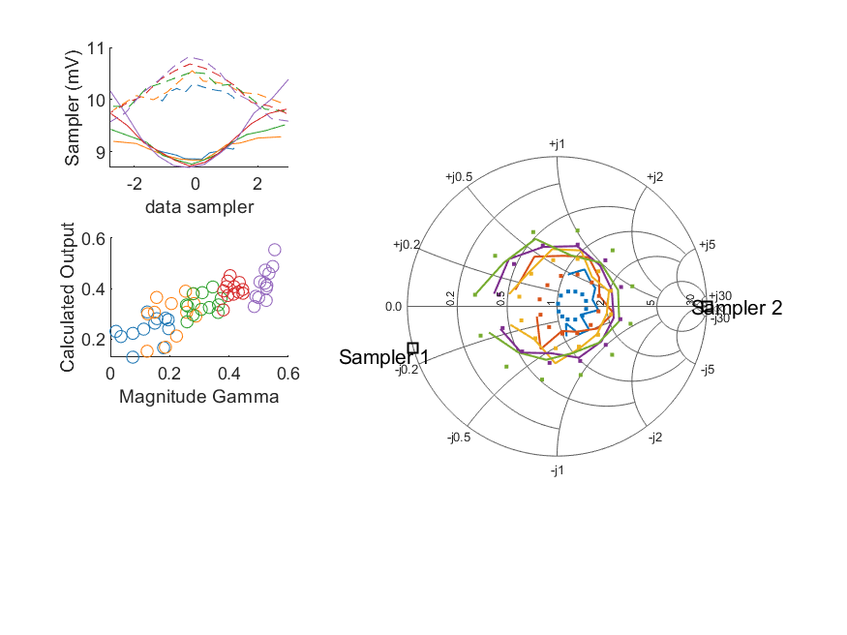
Coupled Line Performance At 11.10 GHz, 16.000000 dBm Output Power 1.00 V mean sampler bias
Sampler Av
Sampler 1: 292.879
Sampler 2: 292.879
Sampler Offset (rather than -1)
-5.6112132294434494
Goodness Of fit
0.20687665075303477
Sampler 1 Range
0.0016887020999999999
Sampler 2 Range
0.0012441351300000007
DUT output dBm Mean
16.030705172026845
DUT input dBm Mean
16.515711671013904
RMS Error
0.095315788275361732

Slide 13
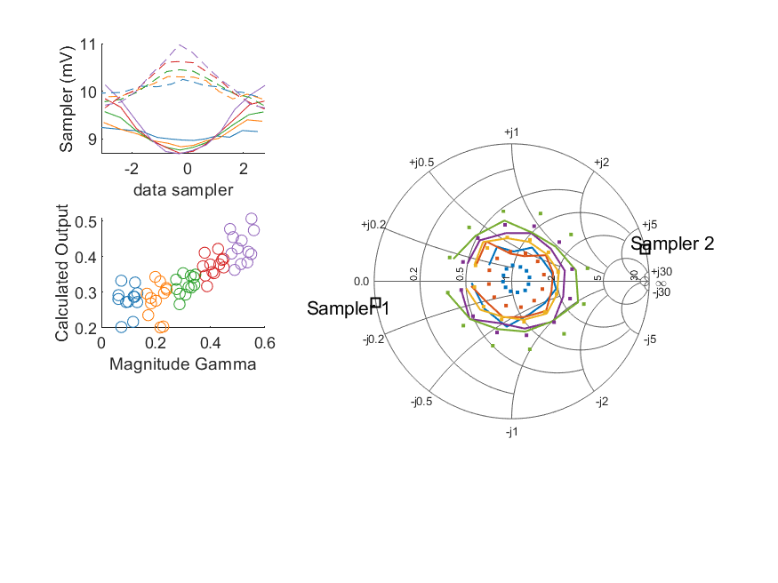
Coupled Line Performance At 11.20 GHz, 16.000000 dBm Output Power 1.00 V mean sampler bias
Sampler Av
Sampler 1: 243.246
Sampler 2: 243.246
Sampler Offset (rather than -1)
-5.1493714956131083
Goodness Of fit
0.20777250226029603
Sampler 1 Range
0.0014482751200000001
Sampler 2 Range
0.0013505879599999999
DUT output dBm Mean
16.018695872269742
DUT input dBm Mean
16.536042265498892
RMS Error
0.10438922372105418

Slide 14
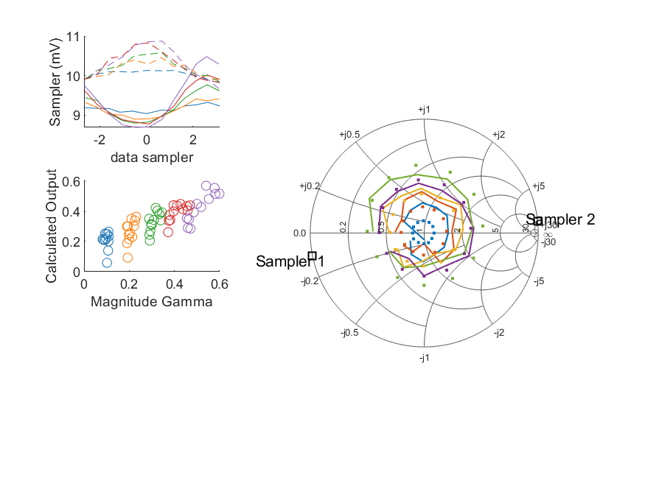
Coupled Line Performance At 11.30 GHz, 16.000000 dBm Output Power 1.00 V mean sampler bias
Sampler Av
Sampler 1: 236.649
Sampler 2: 236.649
Sampler Offset (rather than -1)
-5.1321929586735004
Goodness Of fit
0.16368072586008381
Sampler 1 Range
0.0017959361399999992
Sampler 2 Range
0.0012089034299999999
DUT output dBm Mean
16.019020540766405
DUT input dBm Mean
16.521409250157678
RMS Error
0.089114325147932494

Slide 15
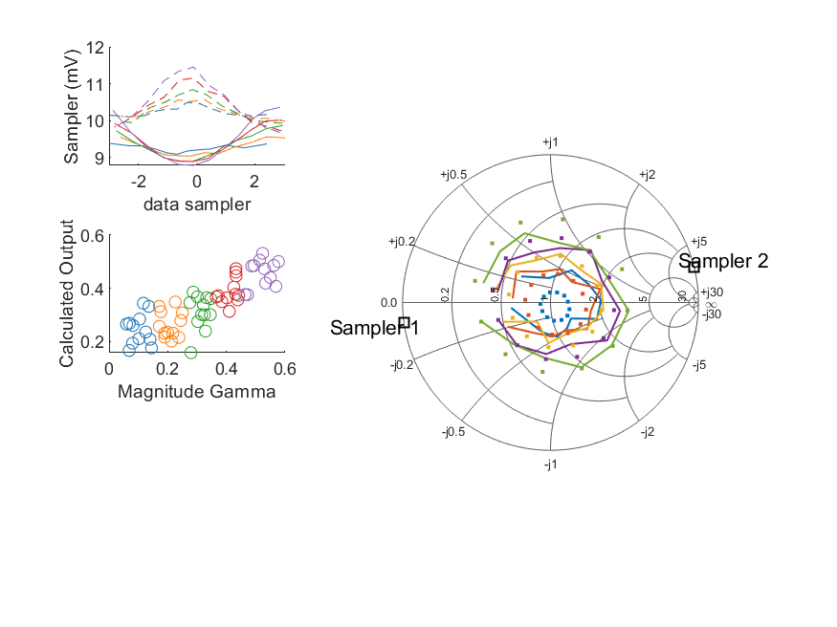
Coupled Line Performance At 11.40 GHz, 16.000000 dBm Output Power 1.00 V mean sampler bias
Sampler Av
Sampler 1: 300.000
Sampler 2: 300.000
Sampler Offset (rather than -1)
-5.7874756244655128
Goodness Of fit
0.17225146430056545
Sampler 1 Range
0.0015747005700000004
Sampler 2 Range
0.0017707691399999996
DUT output dBm Mean
16.0865275767421
DUT input dBm Mean
16.594647363906169
RMS Error
0.093426084458707495

Slide 16
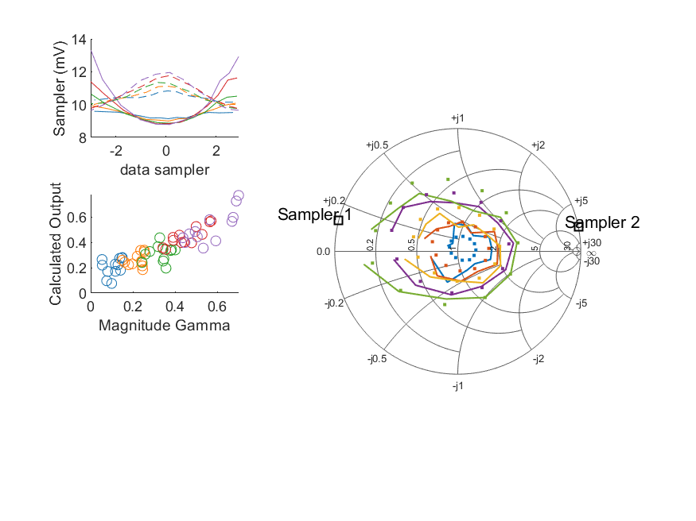
Coupled Line Performance At 10.60 GHz, 18.000000 dBm Output Power 1.00 V mean sampler bias
Sampler Av
Sampler 1: 180.993
Sampler 2: 180.993
Sampler Offset (rather than -1)
-3.7242617148259458
Goodness Of fit
0.17613333824267197
Sampler 1 Range
0.0045181483200000001
Sampler 2 Range
0.0023147161899999998
DUT output dBm Mean
17.959935464873706
DUT input dBm Mean
18.522906070916424
RMS Error
0.080755948079486203

Slide 17
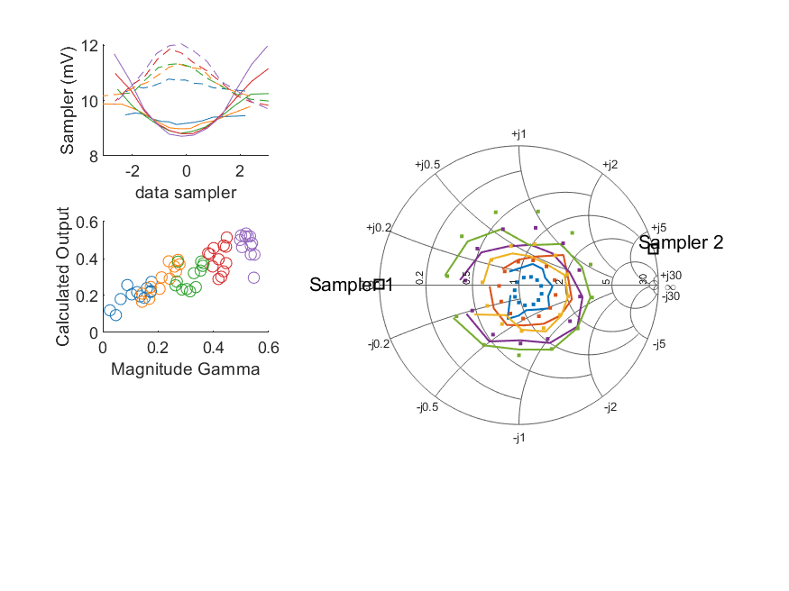
Coupled Line Performance At 10.70 GHz, 18.000000 dBm Output Power 1.00 V mean sampler bias
Sampler Av
Sampler 1: 164.474
Sampler 2: 164.474
Sampler Offset (rather than -1)
-3.8497184626777701
Goodness Of fit
0.17178331220919188
Sampler 1 Range
0.003257606750000001
Sampler 2 Range
0.0023261220199999998
DUT output dBm Mean
17.983129701157413
DUT input dBm Mean
18.413109244257157
RMS Error
0.079699482986542919

Slide 18
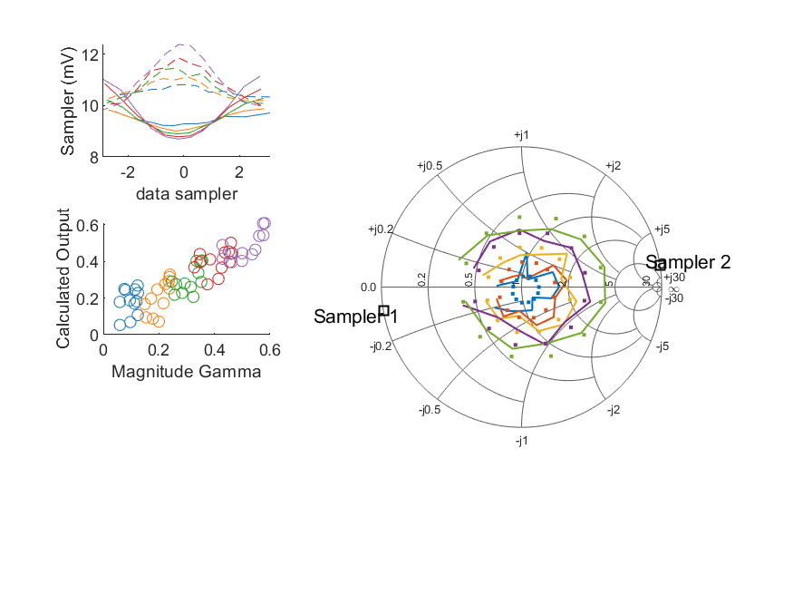
Coupled Line Performance At 10.80 GHz, 18.000000 dBm Output Power 1.00 V mean sampler bias
Sampler Av
Sampler 1: 209.278
Sampler 2: 209.278
Sampler Offset (rather than -1)
-4.7771438848074661
Goodness Of fit
0.099859326622371652
Sampler 1 Range
0.0024560667400000003
Sampler 2 Range
0.0025483097600000008
DUT output dBm Mean
17.97668296547965
DUT input dBm Mean
18.430521963276114
RMS Error
0.072215223895749386

Slide 19
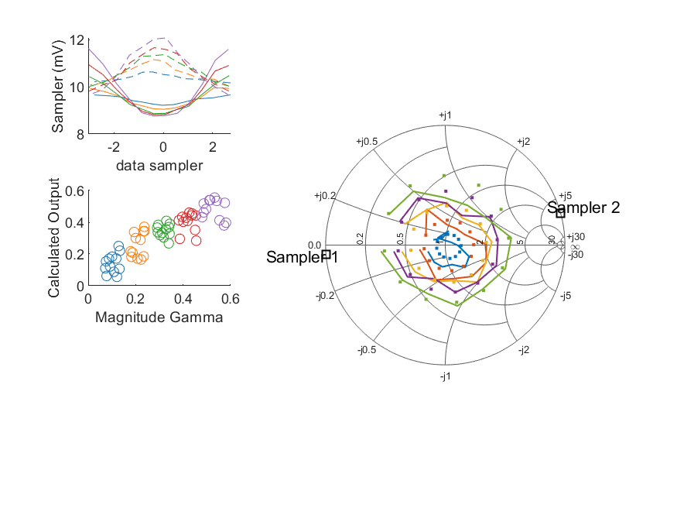
Coupled Line Performance At 10.90 GHz, 18.000000 dBm Output Power 1.00 V mean sampler bias
Sampler Av
Sampler 1: 207.757
Sampler 2: 207.757
Sampler Offset (rather than -1)
-4.545473836787183
Goodness Of fit
0.16862594192967309
Sampler 1 Range
0.0028734214899999999
Sampler 2 Range
0.0024285747199999999
DUT output dBm Mean
17.963245474735846
DUT input dBm Mean
18.48621218809021
RMS Error
0.075477844200657174

Slide 20
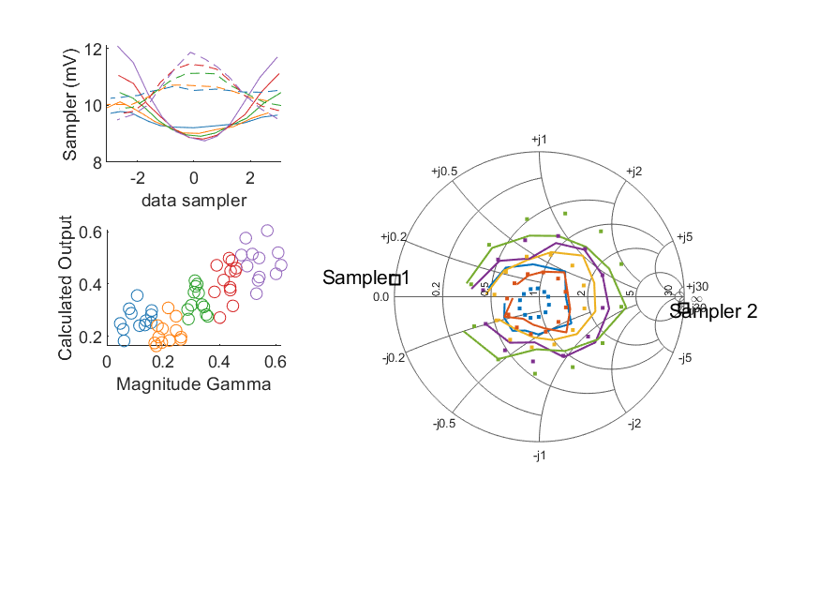
Coupled Line Performance At 11.00 GHz, 18.000000 dBm Output Power 1.00 V mean sampler bias
Sampler Av
Sampler 1: 210.909
Sampler 2: 210.909
Sampler Offset (rather than -1)
-5.0686538737099989
Goodness Of fit
0.23240024444132534
Sampler 1 Range
0.0033468574999999997
Sampler 2 Range
0.0023843007199999995
DUT output dBm Mean
17.993140827736262
DUT input dBm Mean
18.435685851729023
RMS Error
0.097396019377182813

Slide 21

Coupled Line Performance At 11.10 GHz, 18.000000 dBm Output Power 1.00 V mean sampler bias
Sampler Av
Sampler 1: 226.554
Sampler 2: 226.554
Sampler Offset (rather than -1)
-4.9537152764913612
Goodness Of fit
0.096598469494281913
Sampler 1 Range
0.0033778816000000003
Sampler 2 Range
0.0024521222700000008
DUT output dBm Mean
18.008551772026845
DUT input dBm Mean
18.494773337680574
RMS Error
0.068094804007712992

Slide 22
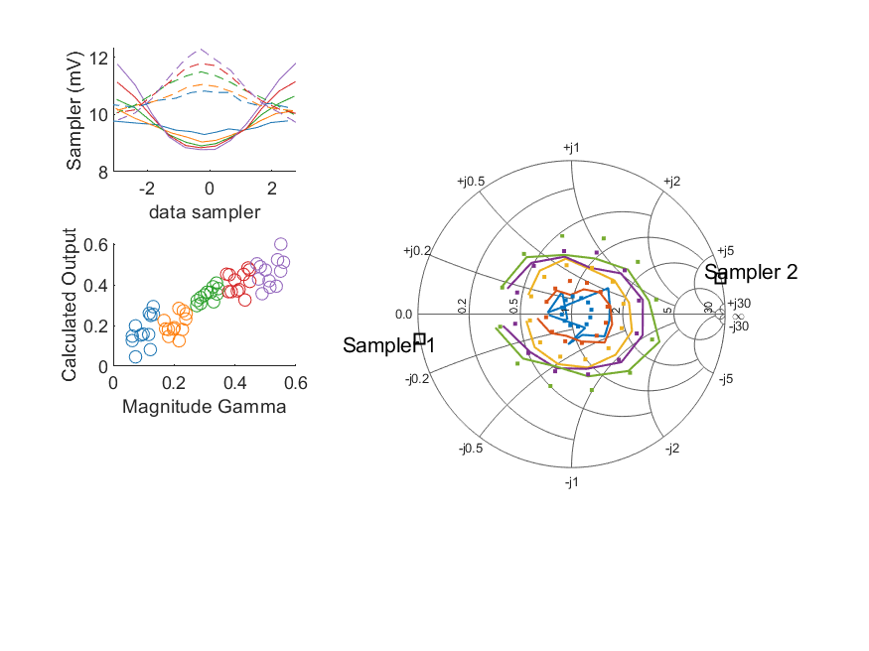
Coupled Line Performance At 11.20 GHz, 18.000000 dBm Output Power 1.00 V mean sampler bias
Sampler Av
Sampler 1: 189.157
Sampler 2: 189.157
Sampler Offset (rather than -1)
-4.6006452455985452
Goodness Of fit
0.11809261748018916
Sampler 1 Range
0.0030164019599999998
Sampler 2 Range
0.00257565274
DUT output dBm Mean
17.979728272269742
DUT input dBm Mean
18.499726432165559
RMS Error
0.076245953617173901

Slide 23
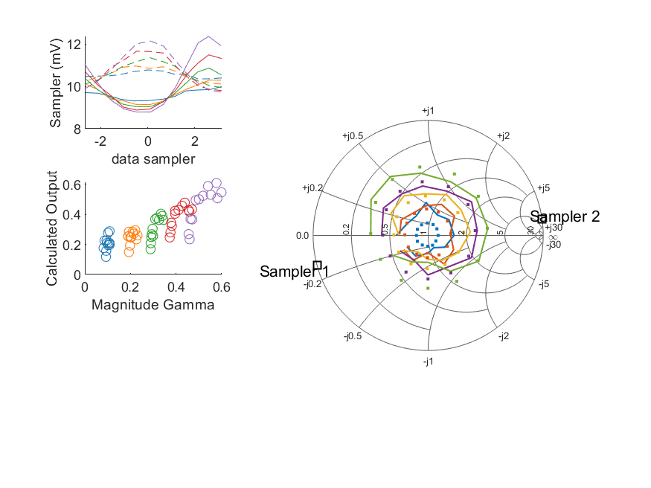
Coupled Line Performance At 11.30 GHz, 18.000000 dBm Output Power 1.00 V mean sampler bias
Sampler Av
Sampler 1: 168.941
Sampler 2: 168.941
Sampler Offset (rather than -1)
-3.9945688737066054
Goodness Of fit
0.13052111850616308
Sampler 1 Range
0.0035670805800000014
Sampler 2 Range
0.0024050320300000004
DUT output dBm Mean
17.990927457433074
DUT input dBm Mean
18.496039083491009
RMS Error
0.081203842967035492

Slide 24

Coupled Line Performance At 11.40 GHz, 18.000000 dBm Output Power 1.00 V mean sampler bias
Sampler Av
Sampler 1: 198.427
Sampler 2: 198.427
Sampler Offset (rather than -1)
-3.8763630508986635
Goodness Of fit
0.1149371538514076
Sampler 1 Range
0.0031735792000000002
Sampler 2 Range
0.0030626643799999999
DUT output dBm Mean
17.980571610075433
DUT input dBm Mean
18.489044197239501
RMS Error
0.071684782208899997

Slide 25
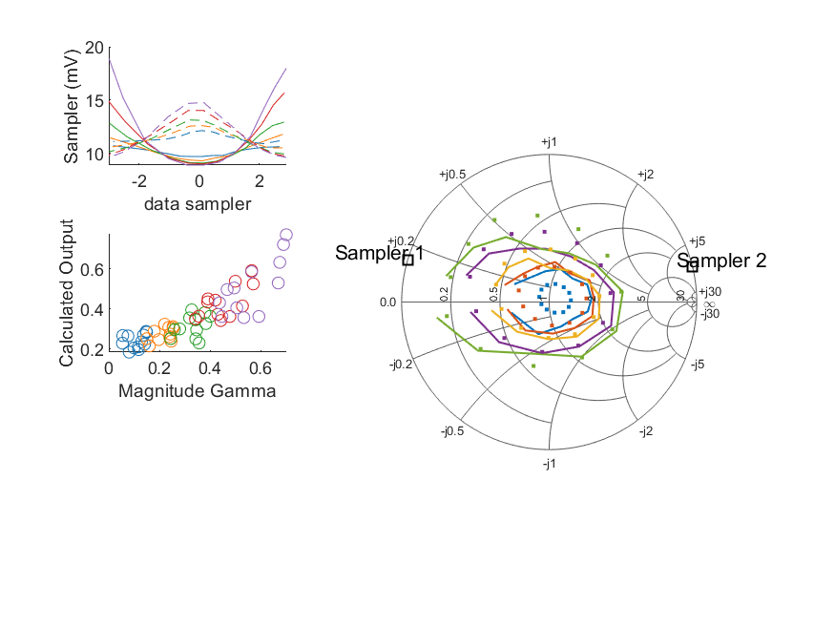
Coupled Line Performance At 10.60 GHz, 20.000000 dBm Output Power 1.00 V mean sampler bias
Sampler Av
Sampler 1: 80.091
Sampler 2: 80.091
Sampler Offset (rather than -1)
-1.7833932334195048
Goodness Of fit
0.22292412256725513
Sampler 1 Range
0.0099566262000000023
Sampler 2 Range
0.0051476555499999996
DUT output dBm Mean
19.95554321154037
DUT input dBm Mean
20.523195237583092
RMS Error
0.090494172337521869

Slide 26
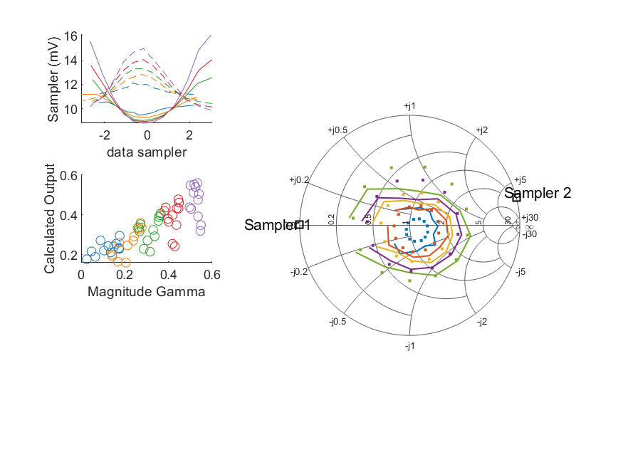
Coupled Line Performance At 10.70 GHz, 20.000000 dBm Output Power 1.00 V mean sampler bias
Sampler Av
Sampler 1: 70.338
Sampler 2: 70.338
Sampler Offset (rather than -1)
-1.8291621486562746
Goodness Of fit
0.18718462838915534
Sampler 1 Range
0.0072822694399999992
Sampler 2 Range
0.0050997337400000009
DUT output dBm Mean
19.974841077824081
DUT input dBm Mean
20.410741244257153
RMS Error
0.087217606154270974

Slide 27
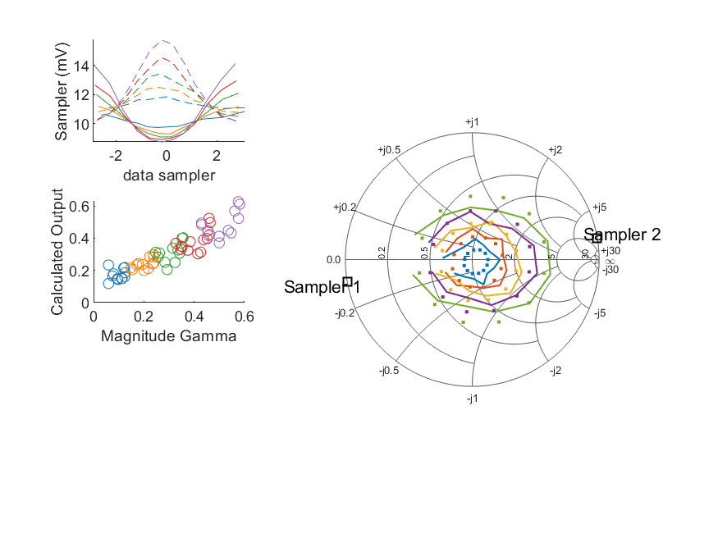
Coupled Line Performance At 10.80 GHz, 20.000000 dBm Output Power 1.00 V mean sampler bias
Sampler Av
Sampler 1: 87.075
Sampler 2: 87.075
Sampler Offset (rather than -1)
-2.1304944704038444
Goodness Of fit
0.10162944433110471
Sampler 1 Range
0.0053848223500000004
Sampler 2 Range
0.0055721395
DUT output dBm Mean
19.958332762146316
DUT input dBm Mean
20.41704446327611
RMS Error
0.063029620667743827

Slide 28
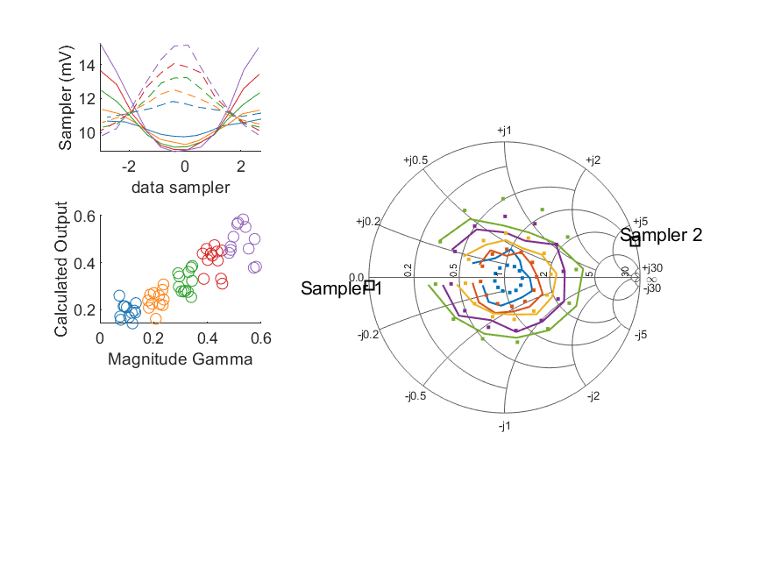
Coupled Line Performance At 10.90 GHz, 20.000000 dBm Output Power 1.00 V mean sampler bias
Sampler Av
Sampler 1: 89.423
Sampler 2: 89.423
Sampler Offset (rather than -1)
-2.106335392365799
Goodness Of fit
0.15735038926192754
Sampler 1 Range
0.0064317378999999997
Sampler 2 Range
0.0054199977599999997
DUT output dBm Mean
19.952081954735846
DUT input dBm Mean
20.47927202142354
RMS Error
0.073491229978221634

Slide 29
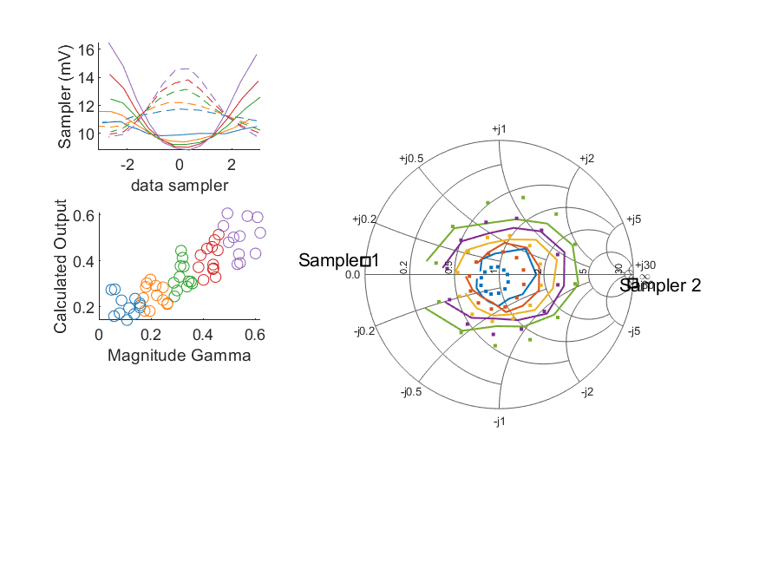
Coupled Line Performance At 11.00 GHz, 20.000000 dBm Output Power 1.00 V mean sampler bias
Sampler Av
Sampler 1: 81.877
Sampler 2: 81.877
Sampler Offset (rather than -1)
-2.2022823700359537
Goodness Of fit
0.19718442534974992
Sampler 1 Range
0.0076628337100000006
Sampler 2 Range
0.0048594526300000003
DUT output dBm Mean
19.977352177736257
DUT input dBm Mean
20.424458351729022
RMS Error
0.083861678203287007

Slide 30
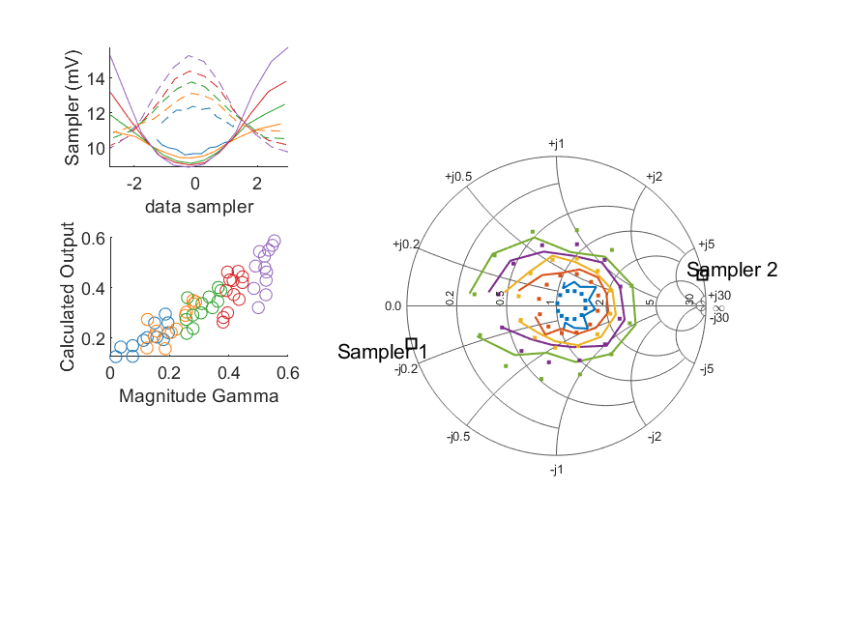
Coupled Line Performance At 11.10 GHz, 20.000000 dBm Output Power 1.00 V mean sampler bias
Sampler Av
Sampler 1: 89.522
Sampler 2: 89.522
Sampler Offset (rather than -1)
-2.0673403987405568
Goodness Of fit
0.11604552506504849
Sampler 1 Range
0.0068900518300000005
Sampler 2 Range
0.0055399417900000008
DUT output dBm Mean
19.994615322026846
DUT input dBm Mean
20.484890337680568
RMS Error
0.067950822157031882

Slide 31
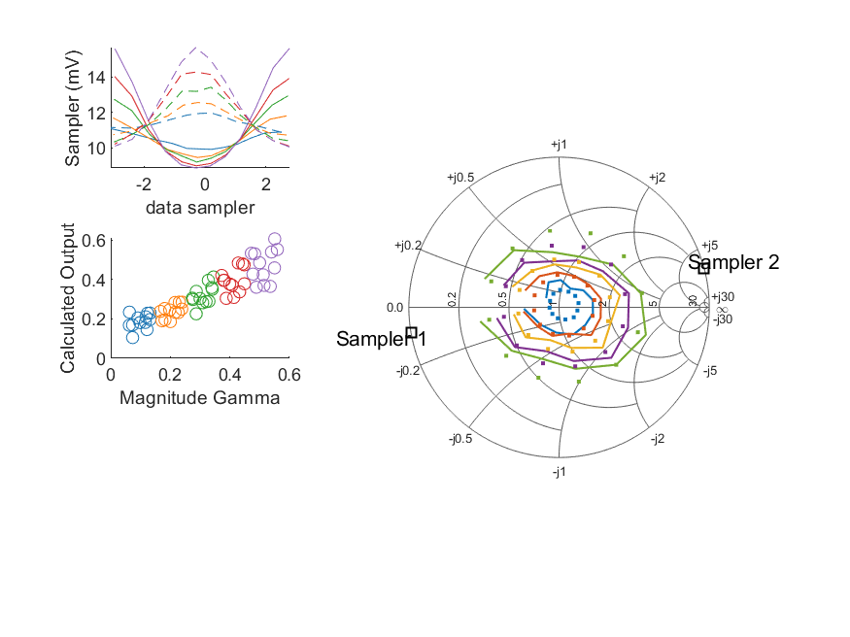
Coupled Line Performance At 11.20 GHz, 20.000000 dBm Output Power 1.00 V mean sampler bias
Sampler Av
Sampler 1: 76.057
Sampler 2: 76.057
Sampler Offset (rather than -1)
-1.9781541987939746
Goodness Of fit
0.12844668961432607
Sampler 1 Range
0.0067455398900000008
Sampler 2 Range
0.0056047476999999991
DUT output dBm Mean
19.96827742226974
DUT input dBm Mean
20.490608598832225
RMS Error
0.069466858598435502

Slide 32

Coupled Line Performance At 11.30 GHz, 20.000000 dBm Output Power 1.00 V mean sampler bias
Sampler Av
Sampler 1: 73.617
Sampler 2: 73.617
Sampler Offset (rather than -1)
-1.8937555063853893
Goodness Of fit
0.11132815065005472
Sampler 1 Range
0.0078562109700000011
Sampler 2 Range
0.0051166942600000005
DUT output dBm Mean
19.988452007433072
DUT input dBm Mean
20.497250916824342
RMS Error
0.073917963082149055

Slide 33
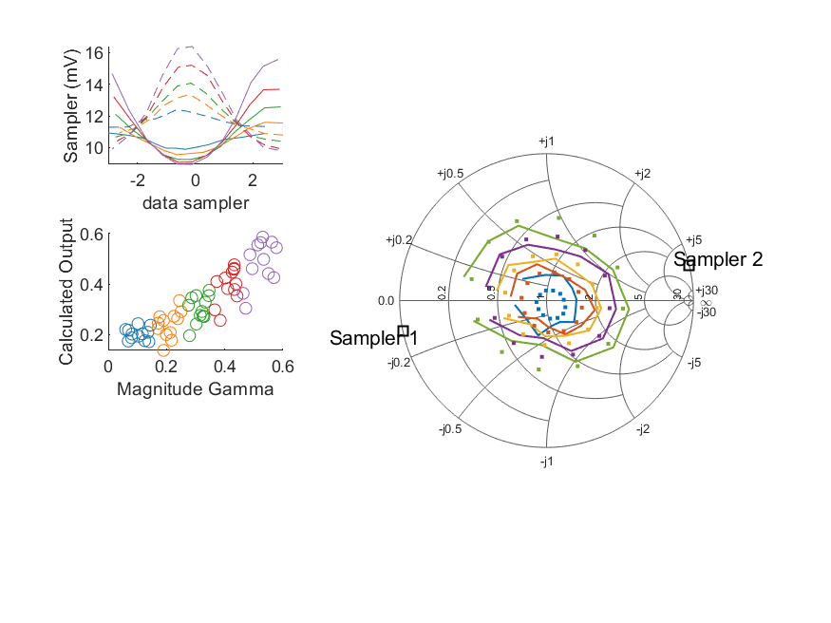
Coupled Line Performance At 11.40 GHz, 20.000000 dBm Output Power 1.00 V mean sampler bias
Sampler Av
Sampler 1: 91.997
Sampler 2: 91.997
Sampler Offset (rather than -1)
-1.9643302205558519
Goodness Of fit
0.12011522293361279
Sampler 1 Range
0.00660045821
Sampler 2 Range
0.006531292670000001
DUT output dBm Mean
19.970183193408769
DUT input dBm Mean
20.479517863906167
RMS Error
0.073786194884650866

Slide 34
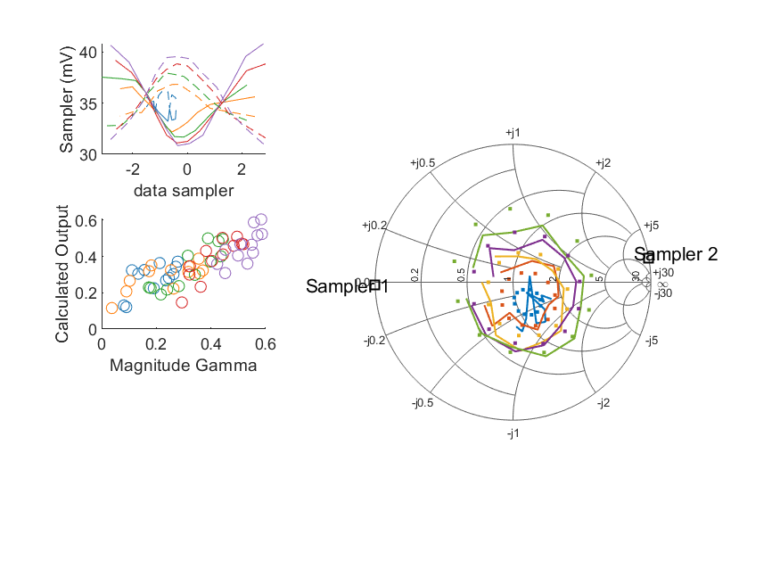
Coupled Line Performance At 10.50 GHz, 12.000000 dBm Output Power 1.25 V mean sampler bias
Sampler Av
Sampler 1: 66.760
Sampler 2: 66.760
Sampler Offset (rather than -1)
-5.6880115650272947
Goodness Of fit
0.18476044191666913
Sampler 1 Range
0.0099674870000000006
Sampler 2 Range
0.0085527537999999965
DUT output dBm Mean
11.976901648866415
DUT input dBm Mean
12.353844049913482
RMS Error
0.088239280012482157

Slide 35
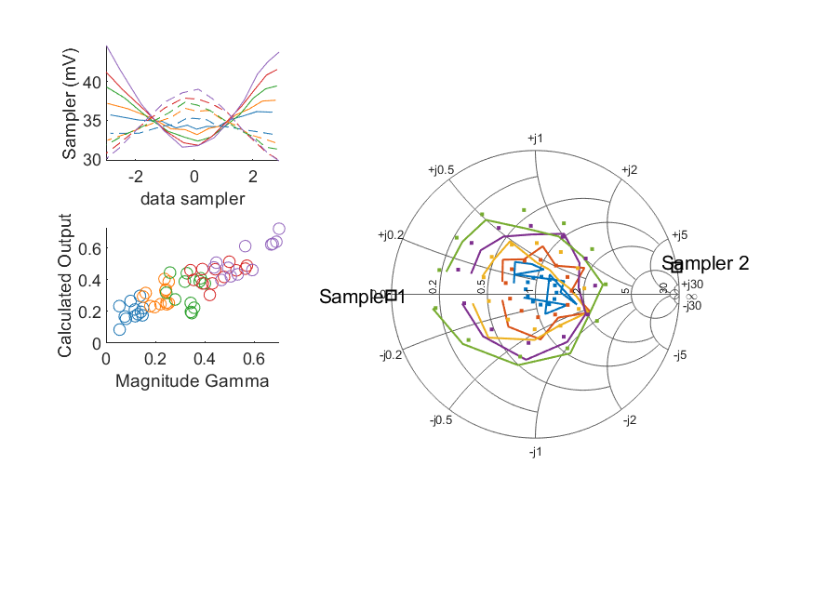
Coupled Line Performance At 10.60 GHz, 12.000000 dBm Output Power 1.25 V mean sampler bias
Sampler Av
Sampler 1: 94.663
Sampler 2: 94.663
Sampler Offset (rather than -1)
-6.8303293882515499
Goodness Of fit
0.2138262246730534
Sampler 1 Range
0.013187516100000005
Sampler 2 Range
0.0093026511999999978
DUT output dBm Mean
11.958798698207039
DUT input dBm Mean
12.513336070916427
RMS Error
0.10041585923039231

Slide 36
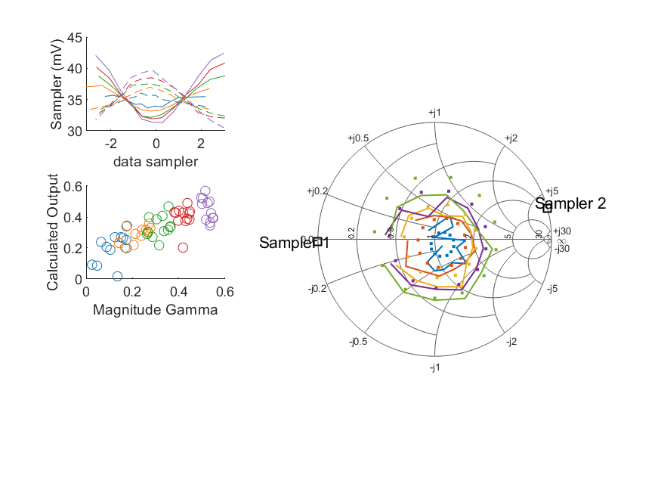
Coupled Line Performance At 10.70 GHz, 12.000000 dBm Output Power 1.25 V mean sampler bias
Sampler Av
Sampler 1: 61.667
Sampler 2: 61.667
Sampler Offset (rather than -1)
-5.0440716382651543
Goodness Of fit
0.22669171708396313
Sampler 1 Range
0.011118621100000003
Sampler 2 Range
0.0092697392999999996
DUT output dBm Mean
11.997153467824084
DUT input dBm Mean
12.418875077590487
RMS Error
0.092326392638123672

Slide 37
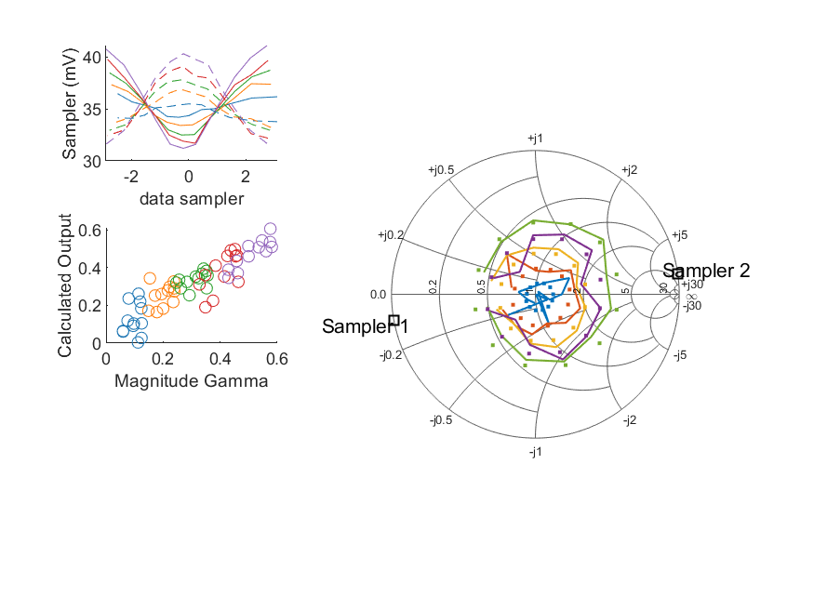
Coupled Line Performance At 10.80 GHz, 12.000000 dBm Output Power 1.25 V mean sampler bias
Sampler Av
Sampler 1: 74.679
Sampler 2: 74.679
Sampler Offset (rather than -1)
-6.1199013076493829
Goodness Of fit
0.10056266441407705
Sampler 1 Range
0.0098907387999999964
Sampler 2 Range
0.0087076105000000042
DUT output dBm Mean
11.975856498812982
DUT input dBm Mean
12.420220629942779
RMS Error
0.076218784734045614

Slide 38
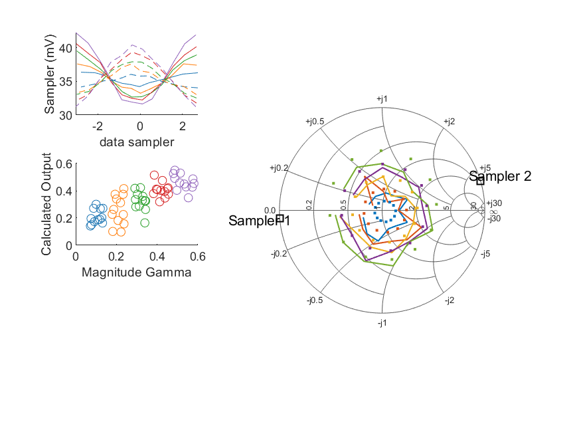
Coupled Line Performance At 10.90 GHz, 12.000000 dBm Output Power 1.25 V mean sampler bias
Sampler Av
Sampler 1: 75.018
Sampler 2: 75.018
Sampler Offset (rather than -1)
-5.8380220928567175
Goodness Of fit
0.24329604226485355
Sampler 1 Range
0.0106039915
Sampler 2 Range
0.0091782476999999994
DUT output dBm Mean
11.969014041402515
DUT input dBm Mean
12.486833688090208
RMS Error
0.096545171826482409

Slide 39
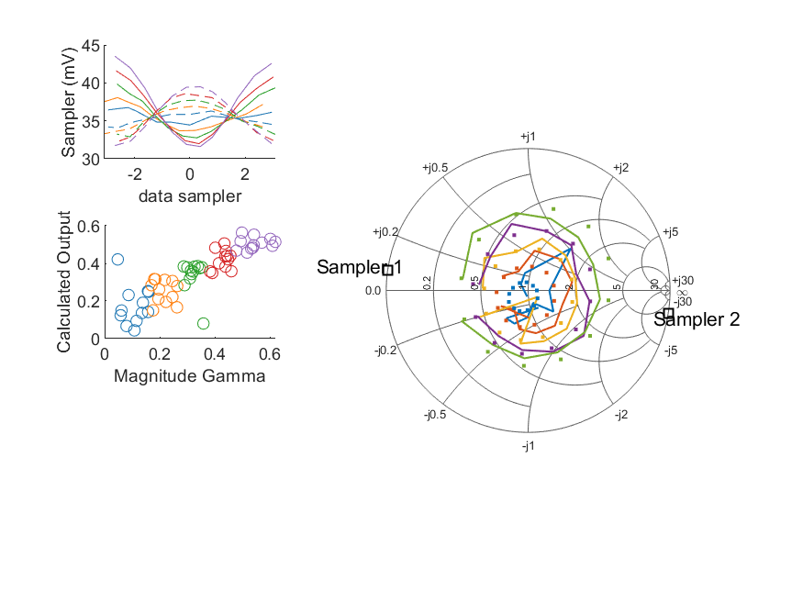
Coupled Line Performance At 11.00 GHz, 12.000000 dBm Output Power 1.25 V mean sampler bias
Sampler Av
Sampler 1: 84.396
Sampler 2: 84.396
Sampler Offset (rather than -1)
-7.4200654359879632
Goodness Of fit
0.17628099120729876
Sampler 1 Range
0.011907188299999996
Sampler 2 Range
0.0077487691999999983
DUT output dBm Mean
11.992998894402925
DUT input dBm Mean
12.428040351729027
RMS Error
0.10747931594289079

Slide 40
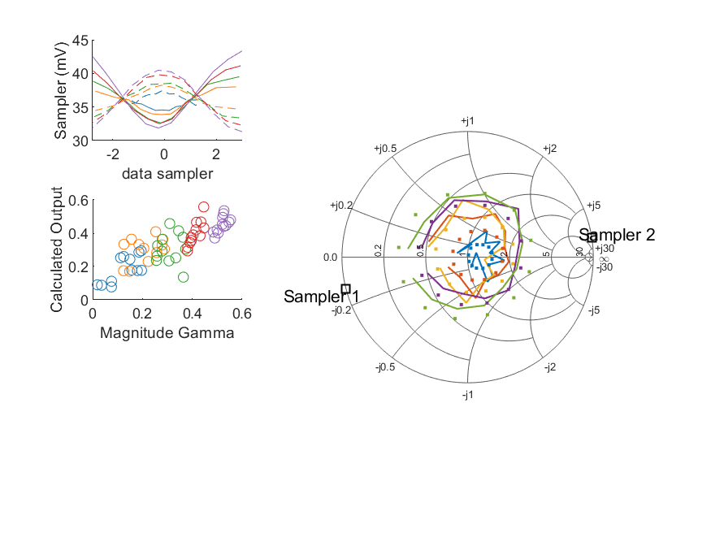
Coupled Line Performance At 11.10 GHz, 12.000000 dBm Output Power 1.25 V mean sampler bias
Sampler Av
Sampler 1: 86.722
Sampler 2: 86.722
Sampler Offset (rather than -1)
-6.6970425494794377
Goodness Of fit
0.18173085854158388
Sampler 1 Range
0.011482643899999999
Sampler 2 Range
0.0091563532000000017
DUT output dBm Mean
12.017527838693509
DUT input dBm Mean
12.502356837680573
RMS Error
0.087542582994581453

Slide 41
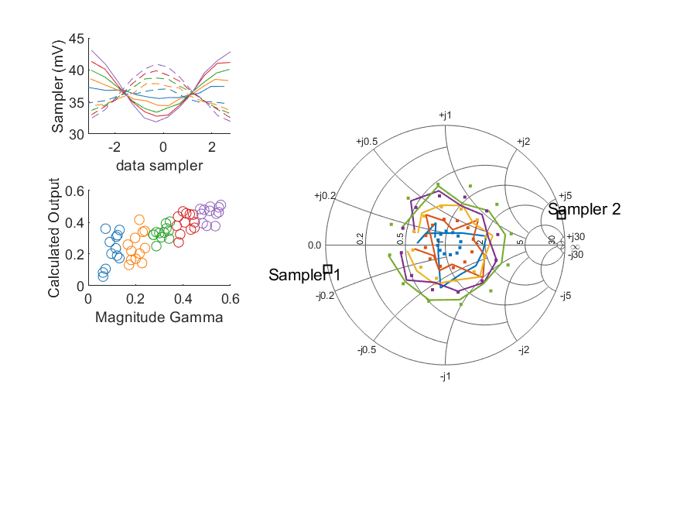
Coupled Line Performance At 11.20 GHz, 12.000000 dBm Output Power 1.25 V mean sampler bias
Sampler Av
Sampler 1: 87.955
Sampler 2: 87.955
Sampler Offset (rather than -1)
-7.3736826207839021
Goodness Of fit
0.18339597467878327
Sampler 1 Range
0.0111880559
Sampler 2 Range
0.008962076200000002
DUT output dBm Mean
11.994101038936408
DUT input dBm Mean
12.505068598832226
RMS Error
0.10491843396305751

Slide 42

Coupled Line Performance At 11.30 GHz, 12.000000 dBm Output Power 1.25 V mean sampler bias
Sampler Av
Sampler 1: 64.690
Sampler 2: 64.690
Sampler Offset (rather than -1)
-5.3697501669120076
Goodness Of fit
0.19732748572235528
Sampler 1 Range
0.011225161599999998
Sampler 2 Range
0.0087220051000000062
DUT output dBm Mean
12.004443240766403
DUT input dBm Mean
12.503734083491009
RMS Error
0.10120905586675095

Slide 43
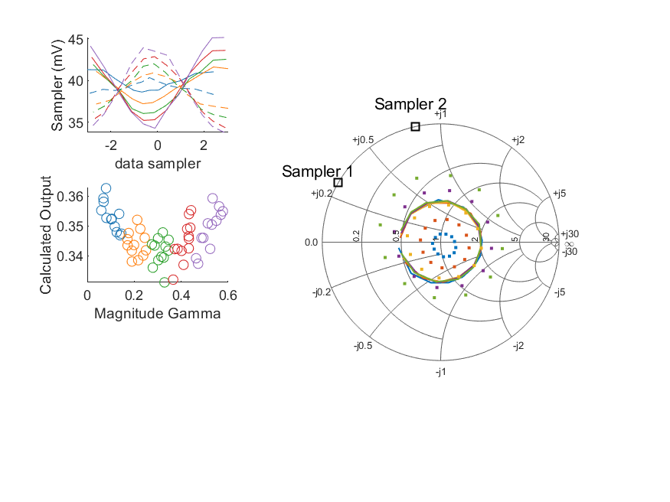
Coupled Line Performance At 11.40 GHz, 12.000000 dBm Output Power 1.25 V mean sampler bias
Sampler Av
Sampler 1: 6.170
Sampler 2: 6.170
Sampler Offset (rather than -1)
-0.3696642513253805
Goodness Of fit
0.56237072846839786
Sampler 1 Range
0.010881632800000006
Sampler 2 Range
0.010130398300000003
DUT output dBm Mean
11.992064560075432
DUT input dBm Mean
12.492317363906171
RMS Error
0.1557529181148937

Slide 44
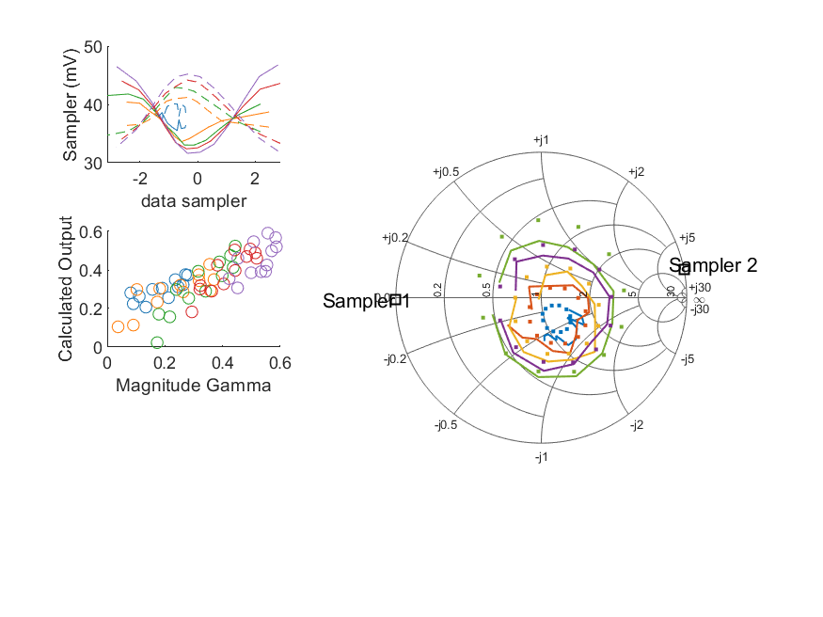
Coupled Line Performance At 10.50 GHz, 14.000000 dBm Output Power 1.25 V mean sampler bias
Sampler Av
Sampler 1: 47.690
Sampler 2: 47.690
Sampler Offset (rather than -1)
-4.3166076460610245
Goodness Of fit
0.18432646997192403
Sampler 1 Range
0.015155860699999996
Sampler 2 Range
0.0131941582
DUT output dBm Mean
13.931799315533082
DUT input dBm Mean
14.31060671658015
RMS Error
0.089423195932687521

Slide 45
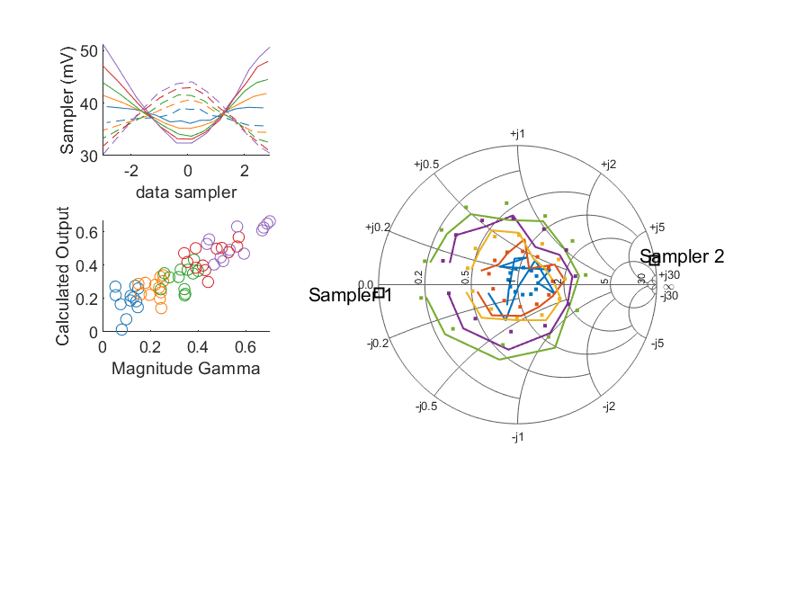
Coupled Line Performance At 10.60 GHz, 14.000000 dBm Output Power 1.25 V mean sampler bias
Sampler Av
Sampler 1: 79.159
Sampler 2: 79.159
Sampler Offset (rather than -1)
-6.3322023033420027
Goodness Of fit
0.17206327346213404
Sampler 1 Range
0.0188729724
Sampler 2 Range
0.0139264305
DUT output dBm Mean
13.916250781540374
DUT input dBm Mean
14.471695737583095
RMS Error
0.094699214205582277

Slide 46
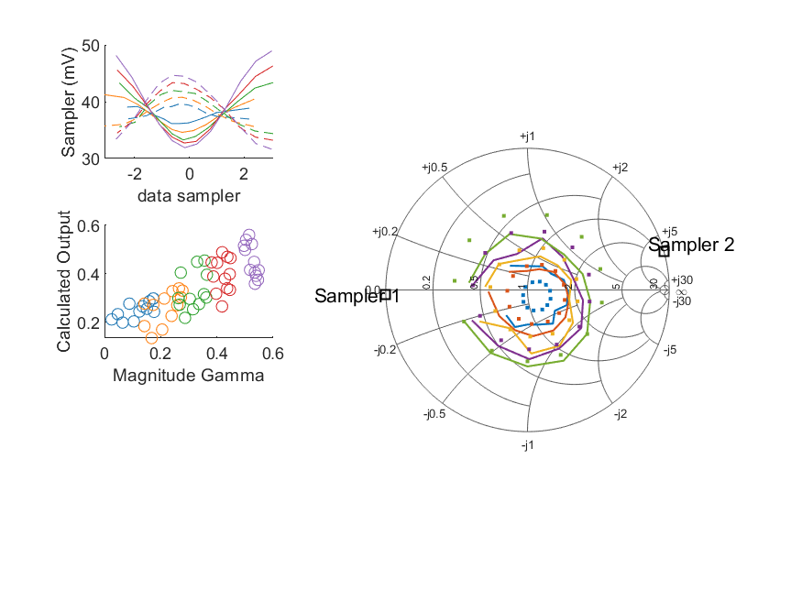
Coupled Line Performance At 10.70 GHz, 14.000000 dBm Output Power 1.25 V mean sampler bias
Sampler Av
Sampler 1: 46.417
Sampler 2: 46.417
Sampler Offset (rather than -1)
-4.1173500384122379
Goodness Of fit
0.23291125173966504
Sampler 1 Range
0.017037334299999998
Sampler 2 Range
0.013024919400000001
DUT output dBm Mean
13.948978601157418
DUT input dBm Mean
14.371430244257152
RMS Error
0.095761492214583258

Slide 47

Coupled Line Performance At 10.80 GHz, 14.000000 dBm Output Power 1.25 V mean sampler bias
Sampler Av
Sampler 1: 64.625
Sampler 2: 64.625
Sampler Offset (rather than -1)
-5.6182787005514996
Goodness Of fit
0.089206937907081757
Sampler 1 Range
0.015074823399999999
Sampler 2 Range
0.013384951000000006
DUT output dBm Mean
13.935490482146317
DUT input dBm Mean
14.380258629942778
RMS Error
0.081901672523549629

Slide 48
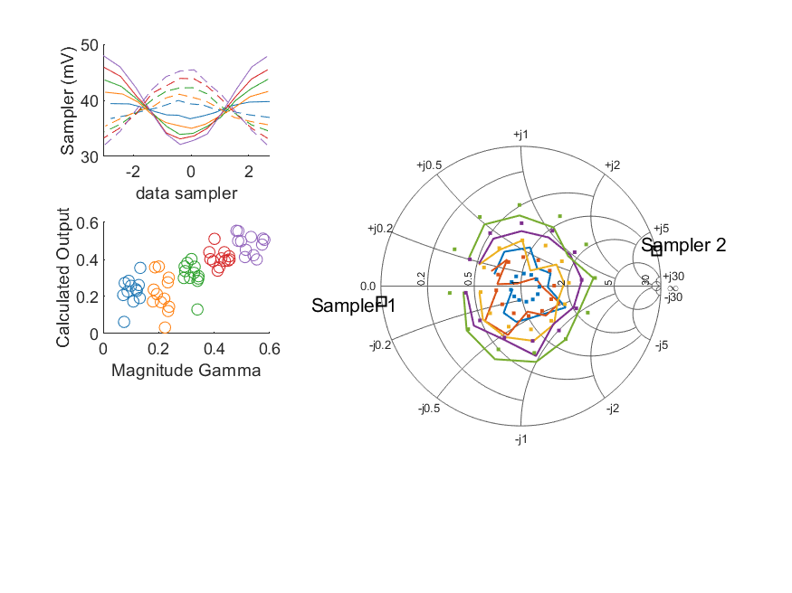
Coupled Line Performance At 10.90 GHz, 14.000000 dBm Output Power 1.25 V mean sampler bias
Sampler Av
Sampler 1: 65.388
Sampler 2: 65.388
Sampler Offset (rather than -1)
-5.5089889653145203
Goodness Of fit
0.19008398416747746
Sampler 1 Range
0.015875308500000004
Sampler 2 Range
0.0136401939
DUT output dBm Mean
13.92341220806918
DUT input dBm Mean
14.440601854756876
RMS Error
0.10281350951157629

Slide 49
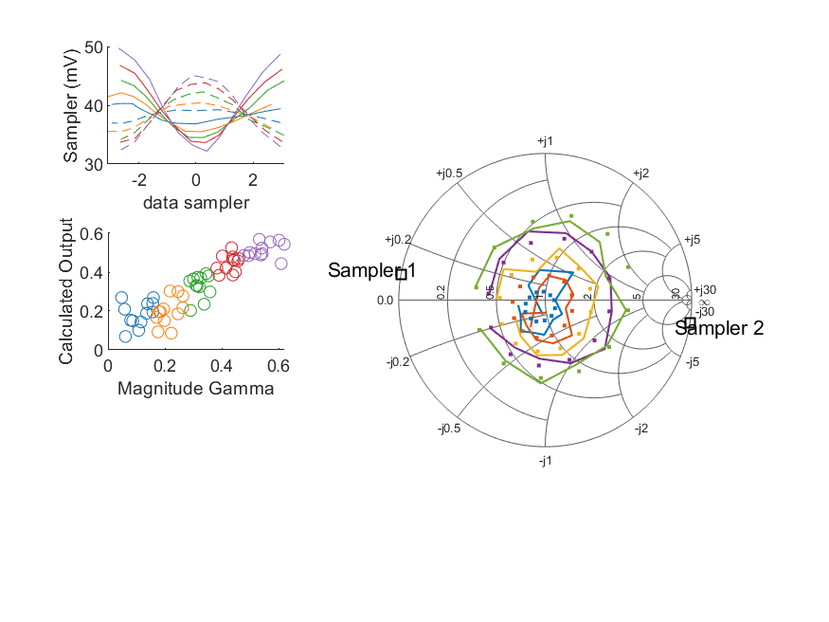
Coupled Line Performance At 11.00 GHz, 14.000000 dBm Output Power 1.25 V mean sampler bias
Sampler Av
Sampler 1: 66.424
Sampler 2: 66.424
Sampler Offset (rather than -1)
-5.9830984682054513
Goodness Of fit
0.10997652253836762
Sampler 1 Range
0.017542516399999999
Sampler 2 Range
0.012923306100000004
DUT output dBm Mean
13.950980761069593
DUT input dBm Mean
14.385472351729023
RMS Error
0.082288213935951565

Slide 50

Coupled Line Performance At 11.10 GHz, 14.000000 dBm Output Power 1.25 V mean sampler bias
Sampler Av
Sampler 1: 66.838
Sampler 2: 66.838
Sampler Offset (rather than -1)
-5.5012321814978309
Goodness Of fit
0.091152803555711787
Sampler 1 Range
0.016800202899999998
Sampler 2 Range
0.013965133599999999
DUT output dBm Mean
13.971304322026844
DUT input dBm Mean
14.456050671013907
RMS Error
0.075972140738802013

Slide 51
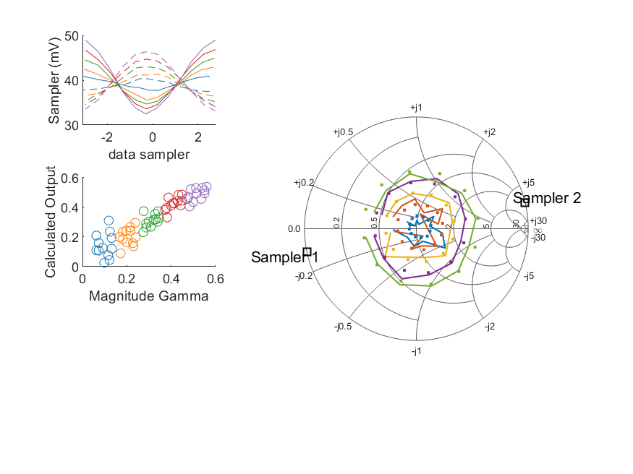
Coupled Line Performance At 11.20 GHz, 14.000000 dBm Output Power 1.25 V mean sampler bias
Sampler Av
Sampler 1: 69.734
Sampler 2: 69.734
Sampler Offset (rather than -1)
-6.3171159106689636
Goodness Of fit
0.061373880055858074
Sampler 1 Range
0.016489588700000002
Sampler 2 Range
0.013261095100000002
DUT output dBm Mean
13.944304438936406
DUT input dBm Mean
14.454856765498896
RMS Error
0.068969130761224684

Slide 52
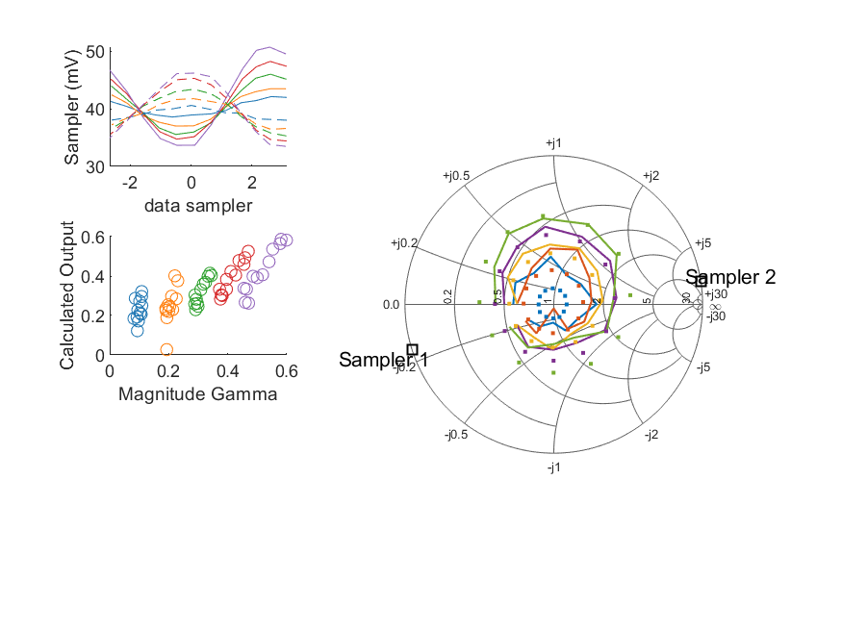
Coupled Line Performance At 11.30 GHz, 14.000000 dBm Output Power 1.25 V mean sampler bias
Sampler Av
Sampler 1: 44.048
Sampler 2: 44.048
Sampler Offset (rather than -1)
-3.8972692376227895
Goodness Of fit
0.18254214938532443
Sampler 1 Range
0.0170844629
Sampler 2 Range
0.012748387100000001
DUT output dBm Mean
13.96108230743307
DUT input dBm Mean
14.459667250157677
RMS Error
0.095326213574028582

Slide 53
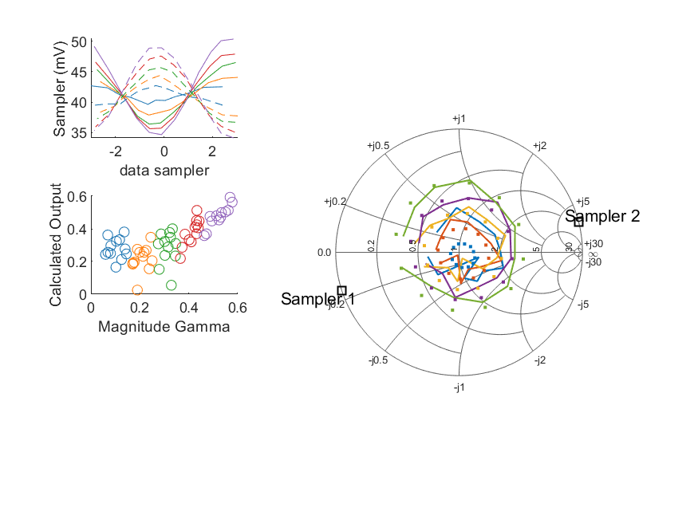
Coupled Line Performance At 11.40 GHz, 14.000000 dBm Output Power 1.25 V mean sampler bias
Sampler Av
Sampler 1: 73.626
Sampler 2: 73.626
Sampler Offset (rather than -1)
-6.1141623458872765
Goodness Of fit
0.17186702128204528
Sampler 1 Range
0.015750750899999999
Sampler 2 Range
0.014851251199999999
DUT output dBm Mean
13.949671293408766
DUT input dBm Mean
14.449901530572836
RMS Error
0.11111047180180254

Slide 54
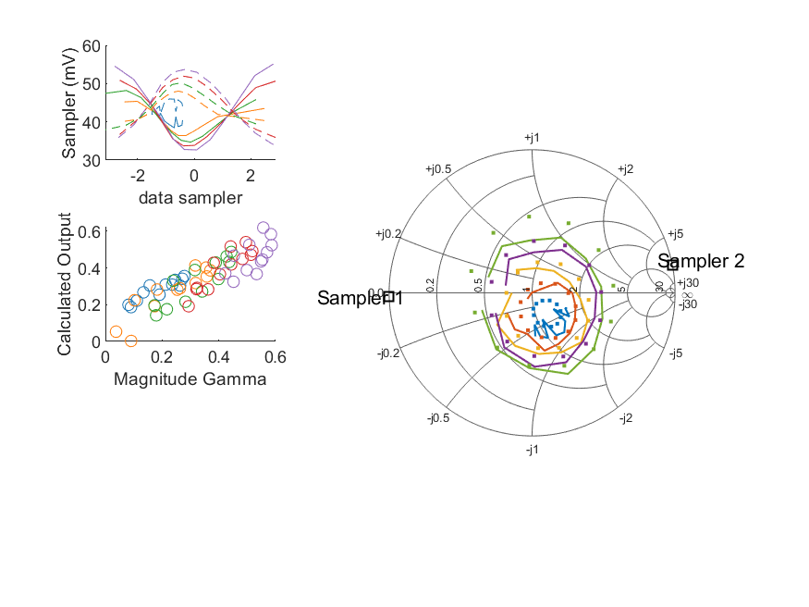
Coupled Line Performance At 10.50 GHz, 16.000000 dBm Output Power 1.25 V mean sampler bias
Sampler Av
Sampler 1: 36.550
Sampler 2: 36.550
Sampler Offset (rather than -1)
-3.6161489585178299
Goodness Of fit
0.15389844729867358
Sampler 1 Range
0.022457569999999996
Sampler 2 Range
0.019641283099999997
DUT output dBm Mean
15.89143031553308
DUT input dBm Mean
16.273465216580146
RMS Error
0.074535898566030601

Slide 55
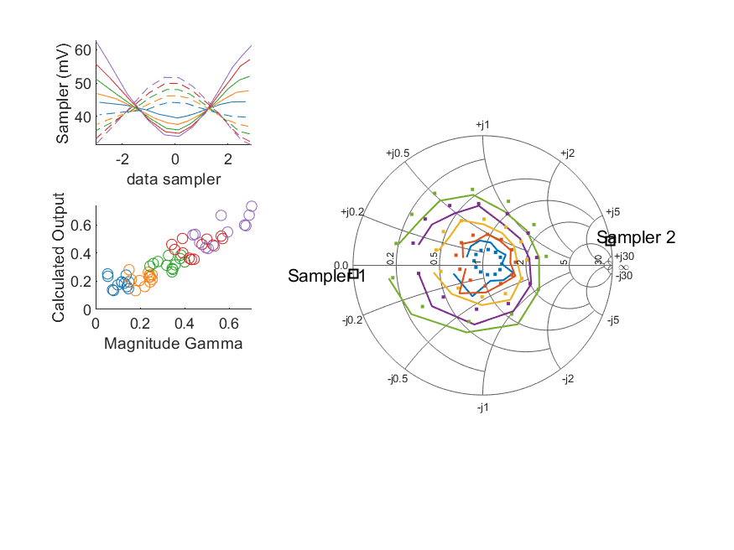
Coupled Line Performance At 10.60 GHz, 16.000000 dBm Output Power 1.25 V mean sampler bias
Sampler Av
Sampler 1: 57.844
Sampler 2: 57.844
Sampler Offset (rather than -1)
-5.156874010816713
Goodness Of fit
0.14314866129258014
Sampler 1 Range
0.028633641600000002
Sampler 2 Range
0.020333512999999998
DUT output dBm Mean
15.884810398207039
DUT input dBm Mean
16.442108404249762
RMS Error
0.069950729469304487

Slide 56
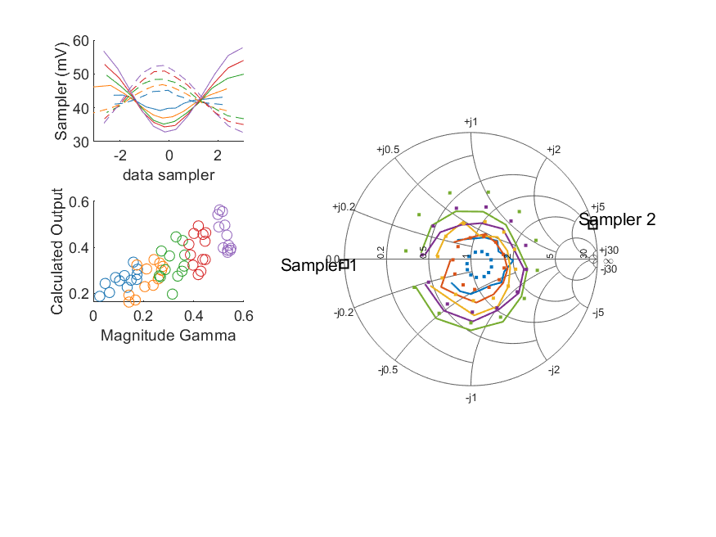
Coupled Line Performance At 10.70 GHz, 16.000000 dBm Output Power 1.25 V mean sampler bias
Sampler Av
Sampler 1: 33.162
Sampler 2: 33.162
Sampler Offset (rather than -1)
-3.2018881217633774
Goodness Of fit
0.24124487948701059
Sampler 1 Range
0.0249005188
Sampler 2 Range
0.019783757999999999
DUT output dBm Mean
15.916556651157418
DUT input dBm Mean
16.340395410923819
RMS Error
0.097461440193402971

Slide 57
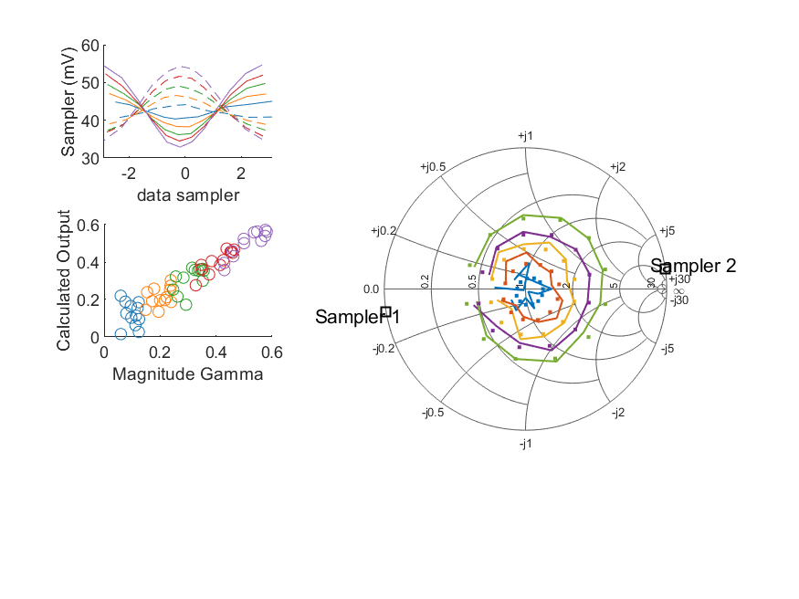
Coupled Line Performance At 10.80 GHz, 16.000000 dBm Output Power 1.25 V mean sampler bias
Sampler Av
Sampler 1: 49.919
Sampler 2: 49.919
Sampler Offset (rather than -1)
-4.7746499965964144
Goodness Of fit
0.035030350219225466
Sampler 1 Range
0.021763994199999998
Sampler 2 Range
0.0196195012
DUT output dBm Mean
15.894892798812984
DUT input dBm Mean
16.341683963276111
RMS Error
0.056414467955425304

Slide 58

Coupled Line Performance At 10.90 GHz, 16.000000 dBm Output Power 1.25 V mean sampler bias
Sampler Av
Sampler 1: 48.400
Sampler 2: 48.400
Sampler Offset (rather than -1)
-4.5046421684376341
Goodness Of fit
0.12364367350783932
Sampler 1 Range
0.023673705000000003
Sampler 2 Range
0.020111986999999998
DUT output dBm Mean
15.889414091402513
DUT input dBm Mean
16.407471021423543
RMS Error
0.073705248140679039

Slide 59

Coupled Line Performance At 11.00 GHz, 16.000000 dBm Output Power 1.25 V mean sampler bias
Sampler Av
Sampler 1: 53.706
Sampler 2: 53.706
Sampler Offset (rather than -1)
-5.4059055058526342
Goodness Of fit
0.10013240638022271
Sampler 1 Range
0.025471547800000001
Sampler 2 Range
0.018684081799999995
DUT output dBm Mean
15.911922727736261
DUT input dBm Mean
16.348084185062355
RMS Error
0.06938782407254504

Slide 60

Coupled Line Performance At 11.10 GHz, 16.000000 dBm Output Power 1.25 V mean sampler bias
Sampler Av
Sampler 1: 49.919
Sampler 2: 49.919
Sampler Offset (rather than -1)
-4.5454364541755954
Goodness Of fit
0.095339316076507558
Sampler 1 Range
0.024319715999999998
Sampler 2 Range
0.021425710100000002
DUT output dBm Mean
15.942208955360179
DUT input dBm Mean
16.428252337680572
RMS Error
0.069662930813925439

Slide 61

Coupled Line Performance At 11.20 GHz, 16.000000 dBm Output Power 1.25 V mean sampler bias
Sampler Av
Sampler 1: 47.359
Sampler 2: 47.359
Sampler Offset (rather than -1)
-4.7384517300271112
Goodness Of fit
0.041589283166151472
Sampler 1 Range
0.0244802046
Sampler 2 Range
0.019892242099999999
DUT output dBm Mean
15.904233455603073
DUT input dBm Mean
16.416128432165561
RMS Error
0.065185095631962439

Slide 62

Coupled Line Performance At 11.30 GHz, 16.000000 dBm Output Power 1.25 V mean sampler bias
Sampler Av
Sampler 1: 20.243
Sampler 2: 20.243
Sampler Offset (rather than -1)
-1.9037483104419031
Goodness Of fit
0.36174149303940928
Sampler 1 Range
0.025819368500000002
Sampler 2 Range
0.019471745799999995
DUT output dBm Mean
15.935904840766405
DUT input dBm Mean
16.435111916824344
RMS Error
0.12250196521142713

Slide 63

Coupled Line Performance At 11.40 GHz, 16.000000 dBm Output Power 1.25 V mean sampler bias
Sampler Av
Sampler 1: 56.966
Sampler 2: 56.966
Sampler Offset (rather than -1)
-5.1425396125402756
Goodness Of fit
0.068560124988438248
Sampler 1 Range
0.022999368499999999
Sampler 2 Range
0.022596572199999998
DUT output dBm Mean
15.908042460075432
DUT input dBm Mean
16.409005530572834
RMS Error
0.06578166198381083

Slide 64

Coupled Line Performance At 10.50 GHz, 8.000000 dBm Output Power 1.50 V mean sampler bias
Sampler Av
Sampler 1: 90.858
Sampler 2: 90.858
Sampler Offset (rather than -1)
-26.972421702022416
Goodness Of fit
0.17459994927922168
Sampler 1 Range
0.0073970910000000223
Sampler 2 Range
0.0072560130000000056
DUT output dBm Mean
7.9812333655330825
DUT input dBm Mean
8.3557300499134826
RMS Error
0.088282578677411502

Slide 65

Coupled Line Performance At 10.60 GHz, 8.000000 dBm Output Power 1.50 V mean sampler bias
Sampler Av
Sampler 1: 164.698
Sampler 2: 164.698
Sampler Offset (rather than -1)
-44.235819832238981
Goodness Of fit
0.16258373943852672
Sampler 1 Range
0.0094606600000000096
Sampler 2 Range
0.0074941700000000222
DUT output dBm Mean
7.9692931482070382
DUT input dBm Mean
8.521566570916427
RMS Error
0.08553275731351119

Slide 66

Coupled Line Performance At 10.70 GHz, 8.000000 dBm Output Power 1.50 V mean sampler bias
Sampler Av
Sampler 1: 87.418
Sampler 2: 87.418
Sampler Offset (rather than -1)
-25.473361039642779
Goodness Of fit
0.21125828702743732
Sampler 1 Range
0.0082072529999999977
Sampler 2 Range
0.007310815000000026
DUT output dBm Mean
8.0038314678240834
DUT input dBm Mean
8.4250674109238215
RMS Error
0.09148613552569905

Slide 67

Coupled Line Performance At 10.80 GHz, 8.000000 dBm Output Power 1.50 V mean sampler bias
Sampler Av
Sampler 1: 127.945
Sampler 2: 127.945
Sampler Offset (rather than -1)
-36.422233275261114
Goodness Of fit
0.10573371834762535
Sampler 1 Range
0.0073352750000000022
Sampler 2 Range
0.0071764889999999804
DUT output dBm Mean
7.985825798812983
DUT input dBm Mean
8.4292806299427792
RMS Error
0.079213229632621077

Slide 68

Coupled Line Performance At 10.90 GHz, 8.000000 dBm Output Power 1.50 V mean sampler bias
Sampler Av
Sampler 1: 130.086
Sampler 2: 130.086
Sampler Offset (rather than -1)
-36.367254524024574
Goodness Of fit
0.16500001188136376
Sampler 1 Range
0.0078094949999999996
Sampler 2 Range
0.0072939159999999836
DUT output dBm Mean
7.9885055747358473
DUT input dBm Mean
8.5024798547568761
RMS Error
0.096940088776964861

Slide 69

Coupled Line Performance At 11.00 GHz, 8.000000 dBm Output Power 1.50 V mean sampler bias
Sampler Av
Sampler 1: 128.941
Sampler 2: 128.941
Sampler Offset (rather than -1)
-38.280008221900161
Goodness Of fit
0.18293566234197911
Sampler 1 Range
0.0085092740000000111
Sampler 2 Range
0.0066572779999999887
DUT output dBm Mean
8.0010092777362605
DUT input dBm Mean
8.4345316850623568
RMS Error
0.085801604031618989

Slide 70

Coupled Line Performance At 11.10 GHz, 8.000000 dBm Output Power 1.50 V mean sampler bias
Sampler Av
Sampler 1: 114.253
Sampler 2: 114.253
Sampler Offset (rather than -1)
-31.130870148689819
Goodness Of fit
0.065254439882457091
Sampler 1 Range
0.0081886340000000002
Sampler 2 Range
0.0076103019999999855
DUT output dBm Mean
8.0240640220268453
DUT input dBm Mean
8.5068956710139041
RMS Error
0.068511531881374849

Slide 71

Coupled Line Performance At 11.20 GHz, 8.000000 dBm Output Power 1.50 V mean sampler bias
Sampler Av
Sampler 1: 137.288
Sampler 2: 137.288
Sampler Offset (rather than -1)
-40.561097242151234
Goodness Of fit
0.10367255319755886
Sampler 1 Range
0.0082758510000000007
Sampler 2 Range
0.0071816849999999932
DUT output dBm Mean
8.0028451556030742
DUT input dBm Mean
8.5142689321655602
RMS Error
0.094228468672412566

Slide 72

Coupled Line Performance At 11.30 GHz, 8.000000 dBm Output Power 1.50 V mean sampler bias
Sampler Av
Sampler 1: 85.759
Sampler 2: 85.759
Sampler Offset (rather than -1)
-24.498549961635266
Goodness Of fit
0.2120590050785589
Sampler 1 Range
0.0084342089999999981
Sampler 2 Range
0.0071582929999999823
DUT output dBm Mean
8.020248490766404
DUT input dBm Mean
8.5177002501576791
RMS Error
0.098551829871338661

Slide 73

Coupled Line Performance At 11.40 GHz, 8.000000 dBm Output Power 1.50 V mean sampler bias
Sampler Av
Sampler 1: 0.000
Sampler 2: 0.000
Sampler Offset (rather than -1)
0.12010390197684058
Goodness Of fit
0.56370615153272896
Sampler 1 Range
0.0078311959999999847
Sampler 2 Range
0.0079742309999999983
DUT output dBm Mean
7.9960461267420992
DUT input dBm Mean
8.4960380305728371
RMS Error
0.15488009368012307

Slide 74

Coupled Line Performance At 10.50 GHz, 10.000000 dBm Output Power 1.50 V mean sampler bias
Sampler Av
Sampler 1: 86.177
Sampler 2: 86.177
Sampler Offset (rather than -1)
-25.50930727916468
Goodness Of fit
0.1337921508114473
Sampler 1 Range
0.011160491999999994
Sampler 2 Range
0.010930565000000003
DUT output dBm Mean
9.9741801988664154
DUT input dBm Mean
10.350952883246814
RMS Error
0.073601707040150066

Slide 75

Coupled Line Performance At 10.60 GHz, 10.000000 dBm Output Power 1.50 V mean sampler bias
Sampler Av
Sampler 1: 127.691
Sampler 2: 127.691
Sampler Offset (rather than -1)
-34.941265461343299
Goodness Of fit
0.15526661141858905
Sampler 1 Range
0.014103694999999999
Sampler 2 Range
0.011405367999999999
DUT output dBm Mean
9.9697424815403721
DUT input dBm Mean
10.523824737583093
RMS Error
0.081228702520278334

Slide 76

Coupled Line Performance At 10.70 GHz, 10.000000 dBm Output Power 1.50 V mean sampler bias
Sampler Av
Sampler 1: 69.972
Sampler 2: 69.972
Sampler Offset (rather than -1)
-20.720976137262909
Goodness Of fit
0.23364253702252952
Sampler 1 Range
0.012430353999999977
Sampler 2 Range
0.010892177000000003
DUT output dBm Mean
10.007310467824084
DUT input dBm Mean
10.429197410923821
RMS Error
0.097872204148642811

Slide 77

Coupled Line Performance At 10.80 GHz, 10.000000 dBm Output Power 1.50 V mean sampler bias
Sampler Av
Sampler 1: 96.513
Sampler 2: 96.513
Sampler Offset (rather than -1)
-27.88495375127399
Goodness Of fit
0.084513975218014209
Sampler 1 Range
0.010785094999999995
Sampler 2 Range
0.010796500999999986
DUT output dBm Mean
9.9834382988129846
DUT input dBm Mean
10.427166963276113
RMS Error
0.083983937729320016

Slide 78

Coupled Line Performance At 10.90 GHz, 10.000000 dBm Output Power 1.50 V mean sampler bias
Sampler Av
Sampler 1: 99.640
Sampler 2: 99.640
Sampler Offset (rather than -1)
-28.566882984417404
Goodness Of fit
0.12977500122193436
Sampler 1 Range
0.011928509000000004
Sampler 2 Range
0.010734596000000013
DUT output dBm Mean
9.9855102414025136
DUT input dBm Mean
10.500243021423541
RMS Error
0.074043400919663646

Slide 79

Coupled Line Performance At 11.00 GHz, 10.000000 dBm Output Power 1.50 V mean sampler bias
Sampler Av
Sampler 1: 102.362
Sampler 2: 102.362
Sampler Offset (rather than -1)
-30.61144703576025
Goodness Of fit
0.13177956404830626
Sampler 1 Range
0.012790217999999992
Sampler 2 Range
0.01051460899999998
DUT output dBm Mean
10.004714111069593
DUT input dBm Mean
10.438169518395689
RMS Error
0.087733890069924825

Slide 80

Coupled Line Performance At 11.10 GHz, 10.000000 dBm Output Power 1.50 V mean sampler bias
Sampler Av
Sampler 1: 107.084
Sampler 2: 107.084
Sampler Offset (rather than -1)
-29.636798888476726
Goodness Of fit
0.078681887890281563
Sampler 1 Range
0.012143113000000011
Sampler 2 Range
0.011563735000000019
DUT output dBm Mean
10.026679688693513
DUT input dBm Mean
10.510261004347237
RMS Error
0.064728904786410107

Slide 81

Coupled Line Performance At 11.20 GHz, 10.000000 dBm Output Power 1.50 V mean sampler bias
Sampler Av
Sampler 1: 108.030
Sampler 2: 108.030
Sampler Offset (rather than -1)
-32.479971316349001
Goodness Of fit
0.056916742259646075
Sampler 1 Range
0.012595155999999996
Sampler 2 Range
0.01050669500000001
DUT output dBm Mean
9.994427322269738
DUT input dBm Mean
10.504426765498893
RMS Error
0.068845078752880914

Slide 82

Coupled Line Performance At 11.30 GHz, 10.000000 dBm Output Power 1.50 V mean sampler bias
Sampler Av
Sampler 1: 61.612
Sampler 2: 61.612
Sampler Offset (rather than -1)
-18.162932376882704
Goodness Of fit
0.16456343548328792
Sampler 1 Range
0.012966223999999998
Sampler 2 Range
0.010764228000000015
DUT output dBm Mean
10.012228990766404
DUT input dBm Mean
10.50920358349101
RMS Error
0.087768346041471157

Slide 83

Coupled Line Performance At 11.40 GHz, 10.000000 dBm Output Power 1.50 V mean sampler bias
Sampler Av
Sampler 1: 111.864
Sampler 2: 111.864
Sampler Offset (rather than -1)
-29.546517369257209
Goodness Of fit
0.16812473398420269
Sampler 1 Range
0.011596018999999985
Sampler 2 Range
0.012488795999999996
DUT output dBm Mean
10.001372293408766
DUT input dBm Mean
10.500631030572837
RMS Error
0.097909193075015874

Slide 84

Coupled Line Performance At 10.50 GHz, 12.000000 dBm Output Power 1.50 V mean sampler bias
Sampler Av
Sampler 1: 53.655
Sampler 2: 53.655
Sampler Offset (rather than -1)
-16.661536885809241
Goodness Of fit
0.15401277535070659
Sampler 1 Range
0.016885579000000012
Sampler 2 Range
0.015688879999999988
DUT output dBm Mean
11.962074148866416
DUT input dBm Mean
12.340633383246816
RMS Error
0.074777998119660044

Slide 85

Coupled Line Performance At 10.60 GHz, 12.000000 dBm Output Power 1.50 V mean sampler bias
Sampler Av
Sampler 1: 84.150
Sampler 2: 84.150
Sampler Offset (rather than -1)
-23.523149040235293
Goodness Of fit
0.15990624482488469
Sampler 1 Range
0.020874276999999997
Sampler 2 Range
0.016521178999999997
DUT output dBm Mean
11.946023048207037
DUT input dBm Mean
12.500793737583091
RMS Error
0.074509337747968613

Slide 86

Coupled Line Performance At 10.70 GHz, 12.000000 dBm Output Power 1.50 V mean sampler bias
Sampler Av
Sampler 1: 48.858
Sampler 2: 48.858
Sampler Offset (rather than -1)
-14.939864310796795
Goodness Of fit
0.23459420987392174
Sampler 1 Range
0.018450012999999987
Sampler 2 Range
0.015665194999999993
DUT output dBm Mean
11.987401901157417
DUT input dBm Mean
12.410640744257156
RMS Error
0.095756088132649242

Slide 87

Coupled Line Performance At 10.80 GHz, 12.000000 dBm Output Power 1.50 V mean sampler bias
Sampler Av
Sampler 1: 75.313
Sampler 2: 75.313
Sampler Offset (rather than -1)
-22.252400325507807
Goodness Of fit
0.044248179947307578
Sampler 1 Range
0.01600753399999999
Sampler 2 Range
0.015651976999999984
DUT output dBm Mean
11.965066332146314
DUT input dBm Mean
12.410148463276112
RMS Error
0.05558578661408322

Slide 88

Coupled Line Performance At 10.90 GHz, 12.000000 dBm Output Power 1.50 V mean sampler bias
Sampler Av
Sampler 1: 71.136
Sampler 2: 71.136
Sampler Offset (rather than -1)
-20.744928006878919
Goodness Of fit
0.13786146626478663
Sampler 1 Range
0.017508558000000007
Sampler 2 Range
0.015968595000000002
DUT output dBm Mean
11.956894758069181
DUT input dBm Mean
12.473272354756878
RMS Error
0.072715283357628432

Slide 89

Coupled Line Performance At 11.00 GHz, 12.000000 dBm Output Power 1.50 V mean sampler bias
Sampler Av
Sampler 1: 75.456
Sampler 2: 75.456
Sampler Offset (rather than -1)
-23.440477444286554
Goodness Of fit
0.10274747500235804
Sampler 1 Range
0.018746940000000017
Sampler 2 Range
0.015228747999999986
DUT output dBm Mean
11.980638194402927
DUT input dBm Mean
12.416053185062356
RMS Error
0.072189370272910447

Slide 90

Coupled Line Performance At 11.10 GHz, 12.000000 dBm Output Power 1.50 V mean sampler bias
Sampler Av
Sampler 1: 70.712
Sampler 2: 70.712
Sampler Offset (rather than -1)
-20.01935882122018
Goodness Of fit
0.081034963890765005
Sampler 1 Range
0.017904447999999989
Sampler 2 Range
0.017097200000000007
DUT output dBm Mean
12.003408738693512
DUT input dBm Mean
12.486450004347239
RMS Error
0.066025838406452639

Slide 91

Coupled Line Performance At 11.20 GHz, 12.000000 dBm Output Power 1.50 V mean sampler bias
Sampler Av
Sampler 1: 76.759
Sampler 2: 76.759
Sampler Offset (rather than -1)
-23.657305376131706
Goodness Of fit
0.043189359507908101
Sampler 1 Range
0.018226338000000009
Sampler 2 Range
0.015800557999999992
DUT output dBm Mean
11.976710622269742
DUT input dBm Mean
12.488137098832226
RMS Error
0.048337169291599265

Slide 92

Coupled Line Performance At 11.30 GHz, 12.000000 dBm Output Power 1.50 V mean sampler bias
Sampler Av
Sampler 1: 41.483
Sampler 2: 41.483
Sampler Offset (rather than -1)
-12.495543667770166
Goodness Of fit
0.20221329296912488
Sampler 1 Range
0.019137532000000013
Sampler 2 Range
0.015658366000000007
DUT output dBm Mean
11.991057524099737
DUT input dBm Mean
12.489418250157678
RMS Error
0.10025328936568347

Slide 93

Coupled Line Performance At 11.40 GHz, 12.000000 dBm Output Power 1.50 V mean sampler bias
Sampler Av
Sampler 1: 80.829
Sampler 2: 80.829
Sampler Offset (rather than -1)
-22.071263985844322
Goodness Of fit
0.088606599920168103
Sampler 1 Range
0.01693072000000001
Sampler 2 Range
0.017886903999999981
DUT output dBm Mean
11.9751175267421
DUT input dBm Mean
12.475797197239501
RMS Error
0.064352916728437154

Slide 94

Coupled Line Performance At 10.50 GHz, 6.000000 dBm Output Power 1.75 V mean sampler bias
Sampler Av
Sampler 1: 184.809
Sampler 2: 184.809
Sampler Offset (rather than -1)
-106.21099227499595
Goodness Of fit
0.11868382229499785
Sampler 1 Range
0.0045692430000000006
Sampler 2 Range
0.0045769679999999591
DUT output dBm Mean
5.943749032199749
DUT input dBm Mean
6.3194050499134811
RMS Error
0.067323212401342147

Slide 95

Coupled Line Performance At 10.60 GHz, 6.000000 dBm Output Power 1.75 V mean sampler bias
Sampler Av
Sampler 1: 238.056
Sampler 2: 238.056
Sampler Offset (rather than -1)
-125.69487031846312
Goodness Of fit
0.11605988007104648
Sampler 1 Range
0.0057679620000000154
Sampler 2 Range
0.0048935099999999898
DUT output dBm Mean
5.9394119815403714
DUT input dBm Mean
6.4895480709164275
RMS Error
0.073238678831845899

Slide 96

Coupled Line Performance At 10.70 GHz, 6.000000 dBm Output Power 1.75 V mean sampler bias
Sampler Av
Sampler 1: 159.172
Sampler 2: 159.172
Sampler Offset (rather than -1)
-91.833691423205465
Goodness Of fit
0.21640607846755736
Sampler 1 Range
0.0051025740000000264
Sampler 2 Range
0.0044653789999999915
DUT output dBm Mean
5.9718098011574163
DUT input dBm Mean
6.3898105775904872
RMS Error
0.090098313587220411

Slide 97

Coupled Line Performance At 10.80 GHz, 6.000000 dBm Output Power 1.75 V mean sampler bias
Sampler Av
Sampler 1: 199.298
Sampler 2: 199.298
Sampler Offset (rather than -1)
-112.6321217499884
Goodness Of fit
0.034845775472391087
Sampler 1 Range
0.0044584999999999764
Sampler 2 Range
0.0046197060000000012
DUT output dBm Mean
5.9394734654796499
DUT input dBm Mean
6.3810132966094466
RMS Error
0.049646474053373461

Slide 98

Coupled Line Performance At 10.90 GHz, 6.000000 dBm Output Power 1.75 V mean sampler bias
Sampler Av
Sampler 1: 228.375
Sampler 2: 228.375
Sampler Offset (rather than -1)
-127.26400257703017
Goodness Of fit
0.099070666117399758
Sampler 1 Range
0.0048089250000000194
Sampler 2 Range
0.0045778960000000257
DUT output dBm Mean
5.9398610747358473
DUT input dBm Mean
6.4548931880902085
RMS Error
0.074293456764669336

Slide 99

Coupled Line Performance At 11.00 GHz, 6.000000 dBm Output Power 1.75 V mean sampler bias
Sampler Av
Sampler 1: 249.759
Sampler 2: 249.759
Sampler Offset (rather than -1)
-146.16463007857649
Goodness Of fit
0.14239422693675299
Sampler 1 Range
0.0053218429999999928
Sampler 2 Range
0.0043521770000000126
DUT output dBm Mean
5.9687441110695927
DUT input dBm Mean
6.4021433517290234
RMS Error
0.088420394555104628

Slide 100

Coupled Line Performance At 11.10 GHz, 6.000000 dBm Output Power 1.75 V mean sampler bias
Sampler Av
Sampler 1: 232.261
Sampler 2: 232.261
Sampler Offset (rather than -1)
-123.85450626496851
Goodness Of fit
0.067430671792508307
Sampler 1 Range
0.0050817620000000452
Sampler 2 Range
0.00510575000000002
DUT output dBm Mean
5.9887988553601774
DUT input dBm Mean
6.4735578376805725
RMS Error
0.076809306046359618

Slide 101

Coupled Line Performance At 11.20 GHz, 6.000000 dBm Output Power 1.75 V mean sampler bias
Sampler Av
Sampler 1: 227.938
Sampler 2: 227.938
Sampler Offset (rather than -1)
-132.3883249078859
Goodness Of fit
0.06525601165034238
Sampler 1 Range
0.005243995999999973
Sampler 2 Range
0.0043834609999999774
DUT output dBm Mean
5.9564289889364082
DUT input dBm Mean
6.4671485988322264
RMS Error
0.069631829690794303

Slide 102

Coupled Line Performance At 11.30 GHz, 6.000000 dBm Output Power 1.75 V mean sampler bias
Sampler Av
Sampler 1: 139.541
Sampler 2: 139.541
Sampler Offset (rather than -1)
-80.358199665165074
Goodness Of fit
0.19350337688034311
Sampler 1 Range
0.0052610539999999872
Sampler 2 Range
0.0044621850000000074
DUT output dBm Mean
5.9789829907664034
DUT input dBm Mean
6.4775144168243459
RMS Error
0.096191606573877639

Slide 103

Coupled Line Performance At 11.40 GHz, 6.000000 dBm Output Power 1.75 V mean sampler bias
Sampler Av
Sampler 1: 0.000
Sampler 2: 0.000
Sampler Offset (rather than -1)
0.11794373098883229
Goodness Of fit
0.56370653398454018
Sampler 1 Range
0.0047481520000000055
Sampler 2 Range
0.0051684830000000015
DUT output dBm Mean
5.9957329600754328
DUT input dBm Mean
6.4953896972395029
RMS Error
0.15488017222093248

Slide 104

Coupled Line Performance At 10.50 GHz, 8.000000 dBm Output Power 1.75 V mean sampler bias
Sampler Av
Sampler 1: 120.508
Sampler 2: 120.508
Sampler Offset (rather than -1)
-70.839842801786418
Goodness Of fit
0.10513836482824636
Sampler 1 Range
0.0070634940000000035
Sampler 2 Range
0.007003301999999989
DUT output dBm Mean
7.9972545321997481
DUT input dBm Mean
8.3717662165801485
RMS Error
0.064880968921078849

Slide 105

Coupled Line Performance At 10.60 GHz, 8.000000 dBm Output Power 1.75 V mean sampler bias
Sampler Av
Sampler 1: 180.408
Sampler 2: 180.408
Sampler Offset (rather than -1)
-97.323170914881686
Goodness Of fit
0.13442486487530764
Sampler 1 Range
0.0091874289999999692
Sampler 2 Range
0.0072643090000000243
DUT output dBm Mean
7.983707648207039
DUT input dBm Mean
8.5374865709164265
RMS Error
0.068348078055991426

Slide 106

Coupled Line Performance At 10.70 GHz, 8.000000 dBm Output Power 1.75 V mean sampler bias
Sampler Av
Sampler 1: 113.058
Sampler 2: 113.058
Sampler Offset (rather than -1)
-65.450678793797465
Goodness Of fit
0.22274272486387003
Sampler 1 Range
0.00815243099999996
Sampler 2 Range
0.0070192129999999686
DUT output dBm Mean
8.0173561344907505
DUT input dBm Mean
8.4386184109238211
RMS Error
0.095812711713534837

Slide 107

Coupled Line Performance At 10.80 GHz, 8.000000 dBm Output Power 1.75 V mean sampler bias
Sampler Av
Sampler 1: 180.232
Sampler 2: 180.232
Sampler Offset (rather than -1)
-100.22270202384586
Goodness Of fit
0.038823969256852026
Sampler 1 Range
0.0068968469999999837
Sampler 2 Range
0.0071721879999999683
DUT output dBm Mean
8.0039032988129826
DUT input dBm Mean
8.4482041299427788
RMS Error
0.06312906213451383

Slide 108

Coupled Line Performance At 10.90 GHz, 8.000000 dBm Output Power 1.75 V mean sampler bias
Sampler Av
Sampler 1: 152.334
Sampler 2: 152.334
Sampler Offset (rather than -1)
-84.348844442006623
Goodness Of fit
0.10419537062371484
Sampler 1 Range
0.0075105919999999826
Sampler 2 Range
0.0071798909999999938
DUT output dBm Mean
7.9927144080691788
DUT input dBm Mean
8.5090730214235428
RMS Error
0.06570597164324414

Slide 109

Coupled Line Performance At 11.00 GHz, 8.000000 dBm Output Power 1.75 V mean sampler bias
Sampler Av
Sampler 1: 165.291
Sampler 2: 165.291
Sampler Offset (rather than -1)
-98.037280235887948
Goodness Of fit
0.11455723264426973
Sampler 1 Range
0.0083571729999999955
Sampler 2 Range
0.0066942290000000515
DUT output dBm Mean
8.0245134444029258
DUT input dBm Mean
8.4563176850623574
RMS Error
0.07979326030502279

Slide 110

Coupled Line Performance At 11.10 GHz, 8.000000 dBm Output Power 1.75 V mean sampler bias
Sampler Av
Sampler 1: 150.396
Sampler 2: 150.396
Sampler Offset (rather than -1)
-80.353456948608681
Goodness Of fit
0.038859225814129351
Sampler 1 Range
0.007875032000000004
Sampler 2 Range
0.007667776000000015
DUT output dBm Mean
8.0455513553601783
DUT input dBm Mean
8.5292453376805728
RMS Error
0.055768976960898227

Slide 111

Coupled Line Performance At 11.20 GHz, 8.000000 dBm Output Power 1.75 V mean sampler bias
Sampler Av
Sampler 1: 178.313
Sampler 2: 178.313
Sampler Offset (rather than -1)
-104.68353979200208
Goodness Of fit
0.039671729652391623
Sampler 1 Range
0.0080703919999999818
Sampler 2 Range
0.0070638679999999732
DUT output dBm Mean
8.0150941556030748
DUT input dBm Mean
8.5261620988322271
RMS Error
0.058945197939876098

Slide 112

Coupled Line Performance At 11.30 GHz, 8.000000 dBm Output Power 1.75 V mean sampler bias
Sampler Av
Sampler 1: 95.096
Sampler 2: 95.096
Sampler Offset (rather than -1)
-54.580808029242881
Goodness Of fit
0.17860625010112813
Sampler 1 Range
0.0084399450000000042
Sampler 2 Range
0.0071463339999999764
DUT output dBm Mean
8.0385119907664038
DUT input dBm Mean
8.5371175834910122
RMS Error
0.095929164004977086

Slide 113

Coupled Line Performance At 11.40 GHz, 8.000000 dBm Output Power 1.75 V mean sampler bias
Sampler Av
Sampler 1: 184.889
Sampler 2: 184.889
Sampler Offset (rather than -1)
-94.469899126573694
Goodness Of fit
0.076754051444916968
Sampler 1 Range
0.0073742409999999481
Sampler 2 Range
0.00805529100000002
DUT output dBm Mean
8.010771293408764
DUT input dBm Mean
8.5130731972395015
RMS Error
0.069582793052675951

Slide 114

Coupled Line Performance At 10.50 GHz, 10.000000 dBm Output Power 1.75 V mean sampler bias
Sampler Av
Sampler 1: 85.997
Sampler 2: 85.997
Sampler Offset (rather than -1)
-51.079753092611647
Goodness Of fit
0.10703009734813881
Sampler 1 Range
0.010968058999999974
Sampler 2 Range
0.010730694000000041
DUT output dBm Mean
9.9810288655330819
DUT input dBm Mean
10.357504216580148
RMS Error
0.059307670919809014

Slide 115

Coupled Line Performance At 10.60 GHz, 10.000000 dBm Output Power 1.75 V mean sampler bias
Sampler Av
Sampler 1: 116.093
Sampler 2: 116.093
Sampler Offset (rather than -1)
-62.655243295937076
Goodness Of fit
0.13361054673102835
Sampler 1 Range
0.013755250999999968
Sampler 2 Range
0.011196201999999988
DUT output dBm Mean
9.9680046482070388
DUT input dBm Mean
10.522904404249761
RMS Error
0.069193008763740793

Slide 116

Coupled Line Performance At 10.70 GHz, 10.000000 dBm Output Power 1.75 V mean sampler bias
Sampler Av
Sampler 1: 78.006
Sampler 2: 78.006
Sampler Offset (rather than -1)
-45.924933408308618
Goodness Of fit
0.20085296358039892
Sampler 1 Range
0.012408986000000011
Sampler 2 Range
0.010554072000000025
DUT output dBm Mean
10.01058163449075
DUT input dBm Mean
10.432706744257155
RMS Error
0.087210422996921486

Slide 117

Coupled Line Performance At 10.80 GHz, 10.000000 dBm Output Power 1.75 V mean sampler bias
Sampler Av
Sampler 1: 105.088
Sampler 2: 105.088
Sampler Offset (rather than -1)
-59.686552182119549
Goodness Of fit
0.013466654248900336
Sampler 1 Range
0.010442765999999992
Sampler 2 Range
0.010829203999999981
DUT output dBm Mean
9.9892811321463171
DUT input dBm Mean
10.434125296609446
RMS Error
0.032415045767258219

Slide 118

Coupled Line Performance At 10.90 GHz, 10.000000 dBm Output Power 1.75 V mean sampler bias
Sampler Av
Sampler 1: 105.042
Sampler 2: 105.042
Sampler Offset (rather than -1)
-58.741610887088186
Goodness Of fit
0.099288682407076681
Sampler 1 Range
0.011522366000000006
Sampler 2 Range
0.010869391000000006
DUT output dBm Mean
9.9890529080691799
DUT input dBm Mean
10.507417188090209
RMS Error
0.057467922330016907

Slide 119

Coupled Line Performance At 11.00 GHz, 10.000000 dBm Output Power 1.75 V mean sampler bias
Sampler Av
Sampler 1: 113.628
Sampler 2: 113.628
Sampler Offset (rather than -1)
-68.149189668261471
Goodness Of fit
0.073680304942814245
Sampler 1 Range
0.012607676999999984
Sampler 2 Range
0.01024660799999999
DUT output dBm Mean
10.002107277736259
DUT input dBm Mean
10.43604501839569
RMS Error
0.065587504162203727

Slide 120

Coupled Line Performance At 11.10 GHz, 10.000000 dBm Output Power 1.75 V mean sampler bias
Sampler Av
Sampler 1: 112.120
Sampler 2: 112.120
Sampler Offset (rather than -1)
-60.793751967143301
Goodness Of fit
0.048351428344836828
Sampler 1 Range
0.01215301799999996
Sampler 2 Range
0.011641928000000024
DUT output dBm Mean
10.03628335536018
DUT input dBm Mean
10.520765671013907
RMS Error
0.052506298352830952

Slide 121

Coupled Line Performance At 11.20 GHz, 10.000000 dBm Output Power 1.75 V mean sampler bias
Sampler Av
Sampler 1: 103.510
Sampler 2: 103.510
Sampler Offset (rather than -1)
-60.939950145629659
Goodness Of fit
0.021292551242992119
Sampler 1 Range
0.0122583
Sampler 2 Range
0.010749918000000025
DUT output dBm Mean
9.9977486556030737
DUT input dBm Mean
10.508204932165558
RMS Error
0.036317463446551845

Slide 122

Coupled Line Performance At 11.30 GHz, 10.000000 dBm Output Power 1.75 V mean sampler bias
Sampler Av
Sampler 1: 63.740
Sampler 2: 63.740
Sampler Offset (rather than -1)
-36.989181537018545
Goodness Of fit
0.16864299821220174
Sampler 1 Range
0.012578963000000054
Sampler 2 Range
0.010589194000000024
DUT output dBm Mean
10.014424324099737
DUT input dBm Mean
10.514219083491012
RMS Error
0.092331746857762687

Slide 123

Coupled Line Performance At 11.40 GHz, 10.000000 dBm Output Power 1.75 V mean sampler bias
Sampler Av
Sampler 1: 118.323
Sampler 2: 118.323
Sampler Offset (rather than -1)
-61.498971590889937
Goodness Of fit
0.045401701693950865
Sampler 1 Range
0.011107083999999989
Sampler 2 Range
0.012387499000000024
DUT output dBm Mean
10.006458460075432
DUT input dBm Mean
10.508432363906168
RMS Error
0.046129310258339384

Slide 124

Coupled Line Performance At 10.50 GHz, 6.000000 dBm Output Power 2.00 V mean sampler bias
Sampler Av
Sampler 1: 225.656
Sampler 2: 225.656
Sampler Offset (rather than -1)
-204.63281405252758
Goodness Of fit
0.093780561715649996
Sampler 1 Range
0.0040868649999999951
Sampler 2 Range
0.0038697309999999874
DUT output dBm Mean
5.9344820321997487
DUT input dBm Mean
6.3085150499134821
RMS Error
0.058507487730411346

Slide 125

Coupled Line Performance At 10.60 GHz, 6.000000 dBm Output Power 2.00 V mean sampler bias
Sampler Av
Sampler 1: 267.074
Sampler 2: 267.074
Sampler Offset (rather than -1)
-217.53446140786966
Goodness Of fit
0.16752942484247074
Sampler 1 Range
0.0048403570000000173
Sampler 2 Range
0.0039505210000000401
DUT output dBm Mean
5.9283219815403729
DUT input dBm Mean
6.4819834042497604
RMS Error
0.10092824132141036

Slide 126

Coupled Line Performance At 10.70 GHz, 6.000000 dBm Output Power 2.00 V mean sampler bias
Sampler Av
Sampler 1: 204.158
Sampler 2: 204.158
Sampler Offset (rather than -1)
-181.25389990072367
Goodness Of fit
0.21237700674945059
Sampler 1 Range
0.0044026189999999965
Sampler 2 Range
0.0039279540000000113
DUT output dBm Mean
5.9622459678240833
DUT input dBm Mean
6.3815640775904878
RMS Error
0.08986775028423416

Slide 127

Coupled Line Performance At 10.80 GHz, 6.000000 dBm Output Power 2.00 V mean sampler bias
Sampler Av
Sampler 1: 250.774
Sampler 2: 250.774
Sampler Offset (rather than -1)
-216.30268876035922
Goodness Of fit
0.038343257918747417
Sampler 1 Range
0.0038135910000000051
Sampler 2 Range
0.0039124429999999877
DUT output dBm Mean
5.9417232988129829
DUT input dBm Mean
6.384909296609445
RMS Error
0.062098140677602914

Slide 128

Coupled Line Performance At 10.90 GHz, 6.000000 dBm Output Power 2.00 V mean sampler bias
Sampler Av
Sampler 1: 291.640
Sampler 2: 291.640
Sampler Offset (rather than -1)
-243.61976217100997
Goodness Of fit
0.12045468584957489
Sampler 1 Range
0.0039165199999999789
Sampler 2 Range
0.0038523669999999677
DUT output dBm Mean
5.9458270747358473
DUT input dBm Mean
6.4588005214235427
RMS Error
0.086868252445606697

Slide 129

Coupled Line Performance At 11.00 GHz, 6.000000 dBm Output Power 2.00 V mean sampler bias
Sampler Av
Sampler 1: 234.216
Sampler 2: 234.216
Sampler Offset (rather than -1)
-215.33153109942884
Goodness Of fit
0.11111870381087881
Sampler 1 Range
0.0043433969999999711
Sampler 2 Range
0.0037845430000000291
DUT output dBm Mean
5.9666262777362586
DUT input dBm Mean
6.3997291850623581
RMS Error
0.084251058697886697

Slide 130

Coupled Line Performance At 11.10 GHz, 6.000000 dBm Output Power 2.00 V mean sampler bias
Sampler Av
Sampler 1: 223.489
Sampler 2: 223.489
Sampler Offset (rather than -1)
-183.74382154975703
Goodness Of fit
0.056109914894761387
Sampler 1 Range
0.0043061589999999761
Sampler 2 Range
0.0042670810000000059
DUT output dBm Mean
5.9842776886935116
DUT input dBm Mean
6.4680471710139065
RMS Error
0.065296813379073587

Slide 131

Coupled Line Performance At 11.20 GHz, 6.000000 dBm Output Power 2.00 V mean sampler bias
Sampler Av
Sampler 1: 231.679
Sampler 2: 231.679
Sampler Offset (rather than -1)
-210.54745467290547
Goodness Of fit
0.055139501282305173
Sampler 1 Range
0.0044722160000000288
Sampler 2 Range
0.0039162830000000204
DUT output dBm Mean
5.9575504889364082
DUT input dBm Mean
6.4663864321655584
RMS Error
0.084380031689530566

Slide 132

Coupled Line Performance At 11.30 GHz, 6.000000 dBm Output Power 2.00 V mean sampler bias
Sampler Av
Sampler 1: 171.526
Sampler 2: 171.526
Sampler Offset (rather than -1)
-152.69624100887791
Goodness Of fit
0.14645677187161174
Sampler 1 Range
0.0048576700000000361
Sampler 2 Range
0.0039027879999999904
DUT output dBm Mean
5.9726874907664049
DUT input dBm Mean
6.4696429168243439
RMS Error
0.086004255890151066

Slide 133

Coupled Line Performance At 11.40 GHz, 6.000000 dBm Output Power 2.00 V mean sampler bias
Sampler Av
Sampler 1: 203.311
Sampler 2: 203.311
Sampler Offset (rather than -1)
-161.79861619120825
Goodness Of fit
0.46173085676477349
Sampler 1 Range
0.0041652950000000133
Sampler 2 Range
0.0045282719999999999
DUT output dBm Mean
5.9921691267420991
DUT input dBm Mean
6.4923318639061698
RMS Error
0.14977789558413052

Slide 134

Coupled Line Performance At 10.50 GHz, 8.000000 dBm Output Power 2.00 V mean sampler bias
Sampler Av
Sampler 1: 142.550
Sampler 2: 142.550
Sampler Offset (rather than -1)
-128.29035355660048
Goodness Of fit
0.09513672018355053
Sampler 1 Range
0.0061155190000000137
Sampler 2 Range
0.006085051000000008
DUT output dBm Mean
8.0079033655330836
DUT input dBm Mean
8.3830235499134833
RMS Error
0.065781289866631579

Slide 135

Coupled Line Performance At 10.60 GHz, 8.000000 dBm Output Power 2.00 V mean sampler bias
Sampler Av
Sampler 1: 190.959
Sampler 2: 190.959
Sampler Offset (rather than -1)
-157.61536884035212
Goodness Of fit
0.10989167079416222
Sampler 1 Range
0.0080554469999999934
Sampler 2 Range
0.0063514479999999818
DUT output dBm Mean
7.9837861482070389
DUT input dBm Mean
8.538393237583092
RMS Error
0.059532605630662754

Slide 136

Coupled Line Performance At 10.70 GHz, 8.000000 dBm Output Power 2.00 V mean sampler bias
Sampler Av
Sampler 1: 137.958
Sampler 2: 137.958
Sampler Offset (rather than -1)
-123.24789804007186
Goodness Of fit
0.18052839698543366
Sampler 1 Range
0.0070592150000000076
Sampler 2 Range
0.0061660089999999723
DUT output dBm Mean
8.0144958011574161
DUT input dBm Mean
8.4359957442571538
RMS Error
0.081717692512772236

Slide 137

Coupled Line Performance At 10.80 GHz, 8.000000 dBm Output Power 2.00 V mean sampler bias
Sampler Av
Sampler 1: 182.088
Sampler 2: 182.088
Sampler Offset (rather than -1)
-157.25618617479975
Goodness Of fit
0.022344823829421864
Sampler 1 Range
0.0058799569999999912
Sampler 2 Range
0.0063041209999999959
DUT output dBm Mean
8.0104581321463169
DUT input dBm Mean
8.4538997966094467
RMS Error
0.042834084025387541

Slide 138

Coupled Line Performance At 10.90 GHz, 8.000000 dBm Output Power 2.00 V mean sampler bias
Sampler Av
Sampler 1: 163.603
Sampler 2: 163.603
Sampler Offset (rather than -1)
-138.73871714594782
Goodness Of fit
0.086614984910442019
Sampler 1 Range
0.006488076999999981
Sampler 2 Range
0.00617542900000001
DUT output dBm Mean
7.9854290747358467
DUT input dBm Mean
8.5018435214235435
RMS Error
0.057434660308785891

Slide 139

Coupled Line Performance At 11.00 GHz, 8.000000 dBm Output Power 2.00 V mean sampler bias
Sampler Av
Sampler 1: 176.260
Sampler 2: 176.260
Sampler Offset (rather than -1)
-161.23101165127778
Goodness Of fit
0.084122796397030783
Sampler 1 Range
0.0071353719999999732
Sampler 2 Range
0.0059748169999999656
DUT output dBm Mean
8.025119444402927
DUT input dBm Mean
8.4590506850623584
RMS Error
0.062635903225946074

Slide 140

Coupled Line Performance At 11.10 GHz, 8.000000 dBm Output Power 2.00 V mean sampler bias
Sampler Av
Sampler 1: 172.728
Sampler 2: 172.728
Sampler Offset (rather than -1)
-141.25677353759329
Goodness Of fit
0.040120094887067137
Sampler 1 Range
0.0067559950000000146
Sampler 2 Range
0.0068135539999999994
DUT output dBm Mean
8.0401273553601786
DUT input dBm Mean
8.5268670043472383
RMS Error
0.067769674648058428

Slide 141

Coupled Line Performance At 11.20 GHz, 8.000000 dBm Output Power 2.00 V mean sampler bias
Sampler Av
Sampler 1: 173.946
Sampler 2: 173.946
Sampler Offset (rather than -1)
-156.473163088566
Goodness Of fit
0.0360108115460651
Sampler 1 Range
0.007160361000000004
Sampler 2 Range
0.0061580709999999872
DUT output dBm Mean
8.0098453222697401
DUT input dBm Mean
8.5209745988322272
RMS Error
0.054922291949499359

Slide 142

Coupled Line Performance At 11.30 GHz, 8.000000 dBm Output Power 2.00 V mean sampler bias
Sampler Av
Sampler 1: 106.548
Sampler 2: 106.548
Sampler Offset (rather than -1)
-93.93953720914844
Goodness Of fit
0.15307773427390758
Sampler 1 Range
0.007316777000000052
Sampler 2 Range
0.0062118259999999759
DUT output dBm Mean
8.0191888240997375
DUT input dBm Mean
8.5185605834910127
RMS Error
0.087691219001555465

Slide 143

Coupled Line Performance At 11.40 GHz, 8.000000 dBm Output Power 2.00 V mean sampler bias
Sampler Av
Sampler 1: 188.407
Sampler 2: 188.407
Sampler Offset (rather than -1)
-149.75362616038112
Goodness Of fit
0.064474353317846705
Sampler 1 Range
0.0065424310000000152
Sampler 2 Range
0.0071826529999999833
DUT output dBm Mean
8.0169771267421002
DUT input dBm Mean
8.5190265305728357
RMS Error
0.066752232816142107

Slide 144

Coupled Line Performance At 10.50 GHz, 10.000000 dBm Output Power 2.00 V mean sampler bias
Sampler Av
Sampler 1: 99.455
Sampler 2: 99.455
Sampler Offset (rather than -1)
-90.072541570126816
Goodness Of fit
0.092993025360024767
Sampler 1 Range
0.0095781760000000493
Sampler 2 Range
0.0094427959999999755
DUT output dBm Mean
9.97354153219975
DUT input dBm Mean
10.351786716580147
RMS Error
0.064416628641849702

Slide 145

Coupled Line Performance At 10.60 GHz, 10.000000 dBm Output Power 2.00 V mean sampler bias
Sampler Av
Sampler 1: 124.081
Sampler 2: 124.081
Sampler Offset (rather than -1)
-102.55776859075439
Goodness Of fit
0.11379593068918709
Sampler 1 Range
0.012269723999999982
Sampler 2 Range
0.0099854609999999733
DUT output dBm Mean
9.9801266482070368
DUT input dBm Mean
10.533499070916427
RMS Error
0.058329149796325586

Slide 146

Coupled Line Performance At 10.70 GHz, 10.000000 dBm Output Power 2.00 V mean sampler bias
Sampler Av
Sampler 1: 85.415
Sampler 2: 85.415
Sampler Offset (rather than -1)
-77.363446020544643
Goodness Of fit
0.17248552890582655
Sampler 1 Range
0.010855659999999989
Sampler 2 Range
0.0093520589999999681
DUT output dBm Mean
10.016852467824084
DUT input dBm Mean
10.439023910923822
RMS Error
0.078935341249962682

Slide 147

Coupled Line Performance At 10.80 GHz, 10.000000 dBm Output Power 2.00 V mean sampler bias
Sampler Av
Sampler 1: 127.398
Sampler 2: 127.398
Sampler Offset (rather than -1)
-110.45351654359571
Goodness Of fit
0.011658655915353953
Sampler 1 Range
0.0091884299999999697
Sampler 2 Range
0.0095344319999999816
DUT output dBm Mean
9.9736839654796494
DUT input dBm Mean
10.417433629942781
RMS Error
0.032675009157804441

Slide 148

Coupled Line Performance At 10.90 GHz, 10.000000 dBm Output Power 2.00 V mean sampler bias
Sampler Av
Sampler 1: 114.520
Sampler 2: 114.520
Sampler Offset (rather than -1)
-97.970595715530351
Goodness Of fit
0.093400107555143413
Sampler 1 Range
0.010148410999999968
Sampler 2 Range
0.0095859860000000463
DUT output dBm Mean
9.9741680747358465
DUT input dBm Mean
10.491449688090206
RMS Error
0.054554818513226397

Slide 149

Coupled Line Performance At 11.00 GHz, 10.000000 dBm Output Power 2.00 V mean sampler bias
Sampler Av
Sampler 1: 122.072
Sampler 2: 122.072
Sampler Offset (rather than -1)
-111.9574162440212
Goodness Of fit
0.063178753221882433
Sampler 1 Range
0.010888977000000022
Sampler 2 Range
0.0091969359999999889
DUT output dBm Mean
10.012251944402927
DUT input dBm Mean
10.448124351729025
RMS Error
0.059097664853086637

Slide 150

Coupled Line Performance At 11.10 GHz, 10.000000 dBm Output Power 2.00 V mean sampler bias
Sampler Av
Sampler 1: 118.697
Sampler 2: 118.697
Sampler Offset (rather than -1)
-97.887250815350853
Goodness Of fit
0.024166673655851581
Sampler 1 Range
0.010633490999999995
Sampler 2 Range
0.010467437999999996
DUT output dBm Mean
10.035619188693511
DUT input dBm Mean
10.521705171013904
RMS Error
0.040587487890889777

Slide 151

Coupled Line Performance At 11.20 GHz, 10.000000 dBm Output Power 2.00 V mean sampler bias
Sampler Av
Sampler 1: 121.972
Sampler 2: 121.972
Sampler Offset (rather than -1)
-110.39146598253016
Goodness Of fit
0.020810200724490753
Sampler 1 Range
0.010745992999999954
Sampler 2 Range
0.0096626169999999845
DUT output dBm Mean
9.9956783222697414
DUT input dBm Mean
10.50654243216556
RMS Error
0.042861123718249537

Slide 152

Coupled Line Performance At 11.30 GHz, 10.000000 dBm Output Power 2.00 V mean sampler bias
Sampler Av
Sampler 1: 70.432
Sampler 2: 70.432
Sampler Offset (rather than -1)
-61.890470522685106
Goodness Of fit
0.14621962226249319
Sampler 1 Range
0.01128498
Sampler 2 Range
0.0096504929999999822
DUT output dBm Mean
10.008646657433074
DUT input dBm Mean
10.508858250157679
RMS Error
0.085585513149857712

Slide 153

Coupled Line Performance At 11.40 GHz, 10.000000 dBm Output Power 2.00 V mean sampler bias
Sampler Av
Sampler 1: 121.480
Sampler 2: 121.480
Sampler Offset (rather than -1)
-96.8818758301028
Goodness Of fit
0.039979897120218835
Sampler 1 Range
0.009793235999999983
Sampler 2 Range
0.011012584999999964
DUT output dBm Mean
10.002152126742097
DUT input dBm Mean
10.503577030572835
RMS Error
0.054202004772305773

